Slide 1
2011-2012 Tenth Annual Student Research Day
Thursday March 22nd 2012
Keating Centre – Conference Centre & Executive Board Room
11:30 a.m. – 5:00 p.m.

Slide 2
“Where are they now?”
Messages & reflections from StFX Student Research Day Alumni

Slide 3
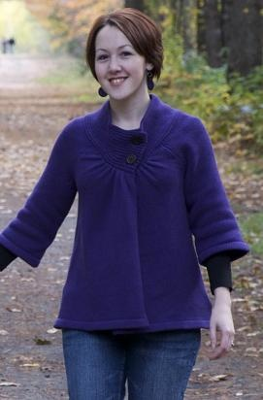
Norma Campbell, ‘03
First Student Research Day BSc (HNu)
I participated in student research day for my thesis work on "Dietary Employees: Attitudes and Beliefs Toward Change”. At the time, I had no idea how valuable completing my thesis and participating in student research day would be.
Since graduating from X, I completed my Integrated Dietetic Internship to become a Professional Dietitian, obtained the professional designation of Certified Diabetes Educator, and most recently, have gone back to school to obtain my MSc. in Community Health & Epidemiology at Dalhousie University. I have been living in Halifax with my husband (a fellow Xaverian) for the past several years, working extensively in community based programs focusing on chronic disease management and research, risk factor management and behaviour change.

Slide 4
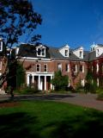
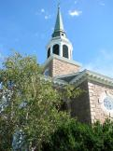
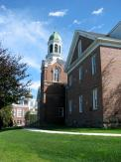
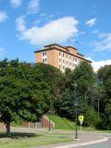
By completing an undergraduate thesis at StFX and participating in student research day, it opened my eyes to the research world and helped strengthen my confidence to pursue it further in my career. (Norma Campbell, ‘03)
What Alumni Have to Say?

Slide 5
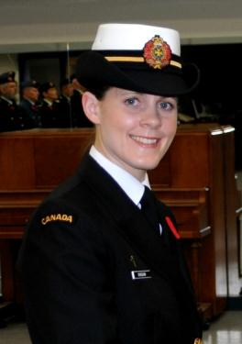
Elisabeth Duggan, ‘03
First Student Research Day BA (Rels)
After completing my degree at StFX, I continued my studies and received a Bachelor of Sacred Theology, Bachelor of Education, and Master of Divinity.
When I was completing my thesis, I decided to participate in the first Student Research Day as an opportunity to show the research students do in the humanities, present my thesis, and be a part of higher education. My education at StFX provided me with the tools to achieve greater knowledge, build a foundation of wisdom in my life, and guided me to continue my theological training.
At present, I am working for the Canadian Forces as a Military Chaplain at CFB Valcartier.

Slide 6
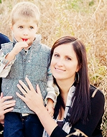
Jennifer (Lewis) McMullen, ‘03
First Student Research Day BScHK
Current Occupation: Physical and Health Education Teacher/Guidance Counsellor at Pickering High School in Ontario and Mom to 2 little munchkins
Degrees Achieved: BSc HK (2003), MSc Kinesiology Dalhousie University (2005), BEd York University (2006)

Slide 7
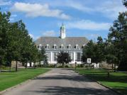
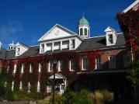
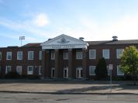
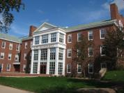
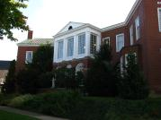
"My time at StFX represents one of the most rewarding experiences of my life. StFX it is truly a gem which I appreciated so much at the time, but it wasn't until I left and attended other universities that I really understood how special it is. I look back on my time there with such great respect and challenge current students to get the most out of their time at X socially, academically and spiritually. The first annual research day gave me an opportunity to share my research with others and it was great to feel validated from comments from all who attended. The research day ignited a passion in me and lead me to pursue research in the future. Working with Dr. Angie Thompson on not only my honours research at StFX but also my master's degree at Dalhousie was such a rich educational experience for me. To all students, enjoy the research day and congrats!“ (Jennifer [Lewis] McMullen, ‘03)
What Alumni Have to Say?

Slide 8
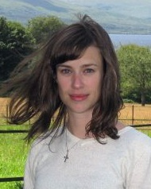
Elaine Moody, ‘03
First Student Research Day BSc (Nurs)
At the my Student Research Day, I presented the findings from my honours thesis that I completed as part of my nursing degree.
It's not often I feel old but thinking back to that day and remembering how we used cloth to cover the board and printed the results to mount on coloured cardboard, it really does feel like another age! I also remember having to find paper journals for my literature review; a lost art in the current world of electronic journal access.

Slide 9
Our honours class was small and close knit. I had some very close friends in the program and we had fun working on our projects. We were proud to present our results at the student research day and hoped that they would lead to great things. My time at StFX and the BScN honours program sparked a love of research for me. After obtaining my degree and working as an RN for three years I went back to school. I received my MSN in 2008 and am now in the fourth year of my PhD program, both at UBC. My dissertation is exploring how nurses come to understand the cognitive function of their older patients in hospital, with a particular focus on the social and contextual factors that influence their understandings. (Elaine Moody, ’03)
What Alumni Have to Say?

Slide 10
Bev Moylan, ‘04
Second Student Research Day BSc (HKin)
Current Occupation/Education: Medical Resident, University of Toronto Division of Physiatry
Degrees Achieved:
Physiatry Residency - FRCPC (Fellow of The Royal College of Physicians of Canada) at the University of Toronto. Predicted Graduation 2015
Medical Degree, University of Calgary (2010)
MA, Physical Education and Recreation, University of Alberta (2007)

Slide 11
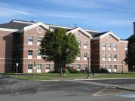
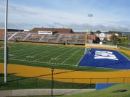
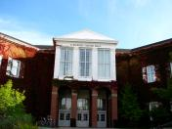
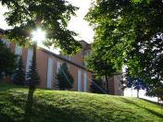
Research Day was my first exposure to the world of research dissemination. Learning the steps from literature review to poster design helped to prepare me for my Master's Degree. Standing by my poster and sharing my ideas and findings with others increased my enthusiasm for research. This was one of the many fantastic experiences I had at StFX. (Bev Moylan, ‘04)
What Alumni Have to Say?

Slide 12
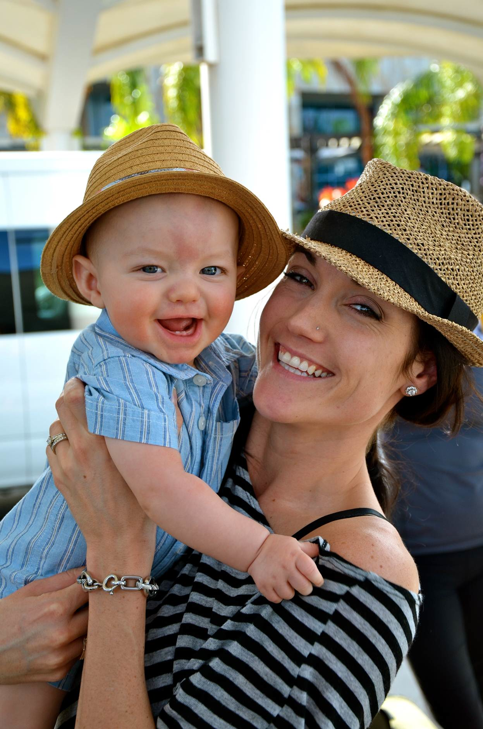
Katie Faloon-Drew, ‘04
Second Student Research Day BSc (HKin)
I completed a Bachelor of Science degree in Human Kinetics and had the honour of doing an undergraduate thesis in 4th year with Dr. Angie Thompson in the area of physical activity promotion/child obesity.
Equipped with my new-found passion for promoting healthy living and the great educational backing from StFX, I was accepted into the graduate program at Queens University and completed a Master of Science degree in Health Promotion/Health Psychology. My education from ST.FX coupled with my Masters Degree in Health Promotion led me to my current job as a policy analyst in the federal government.
My first four years were spent at the Public Health Agency of Canada in the Healthy Living Unit and I am now at Health Canada in the Office of Nutrition Policy and Promotion working on the Obesity file. I am also a Health and Confidence Coach on the side and love to blog about healthy living and feeling great about who you are inside and out (www.healthyconfidentyou.wordpress.com).

Slide 13
StFX was the most amazing educational, personal and social experience of my life. I wouldn't be where I am now if it wasn’t for the great foundation StFX provided me. Specifically, research day was not only a wonderful opportunity to showcase my hard work but it was a great way to learn the importance of networking and confidently presenting oneself and one's work in front of others, all crucial when entering the working world! I wear my X-ring to this day and will always remember my "roots". Hail and Health! (Katie Faloon-Drew, ‘04)
What Alumni Have to Say?

Slide 14
Kristie Mahoney, ‘05
Third Student Research Day BSc (ESci)
Current Occupation: Research Assistant, Department of Environmental Sciences at Nova Scotia Agricultural College. Our research is focused on Integrated Nutrient Management in agriculture to promote sustainability in soil nutrient management.
Degrees achieved:
B. Sc. 2005 (StFX) Earth Sciences
M. Sc. 2010 (StFX) Earth Sciences

Slide 15
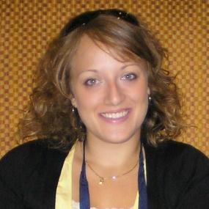
Amanda Cherpak, ‘05
Third Student Research Day BSc (Phys)
I participated in the Student Research Day as a fourth year physics student at StFX in 2005, presenting research I had done with Dr. Peter Poole of the physics department. Aside from the encouragement and support from StFX, I fondly remember the overwhelming community involvement as people from all over Antigonish attended to hear about the work we had done.
Since my days at StFX, I moved to Ottawa to attend Carleton University and this past November I successfully defended my PhD in Medical Physics. My research was focused on the physics of radiation therapy and how we can optimize cancer treatment and patient safety. I have also had the honour of having my work published in the peer-reviewed journals Medical Physics and Radiotherapy Oncology.
I am currently a Medical Physics Resident at the Ottawa Hospital Cancer Centre, where Medical Physicists are part of the health care team, working with Radiation Oncologists and Radiation Therapists to ensure accurate delivery of radiation therapy to patients.

Slide 16
The Annual Student Research Day was the first in a long line of conference presentations I have taken part in and it was a perfect way to get started. It was Dr. Doug Hunter, the head of the physics department at the time, who convinced me to continue research and try grad school and he helped me believe it was something I could achieve. I'm not sure where else professors and community members would take such a personal interest in the success of undergraduate students and invest so much in their future.
I wish a sincere thank you to you, Dr. Thompson, for seeing the value in encouraging undergraduate research and academic excellence and to the whole Xaverian community for getting me to where I am today. (Amanda Cherpak, ‘05)
What Alumni Have to Say?

Slide 17
Patrick McLane, ‘06
Fourth Student Research Day BA (Soc)
After graduating StFX, where I studied sociology with Dr. Patricia Cormack, I went on to complete an MA in Sociology at York University in Toronto, and am currently a Doctoral Candidate at the University of Alberta. My SSHRC funded research focuses on the idea of citizenship and the role it plays in Canada's national security law.

Slide 18
Research Day is an excellent event because it showcases the great work undergraduates do at StFX. (Patrick McLane, ‘06)
What Alumni Have to Say?

Slide 19
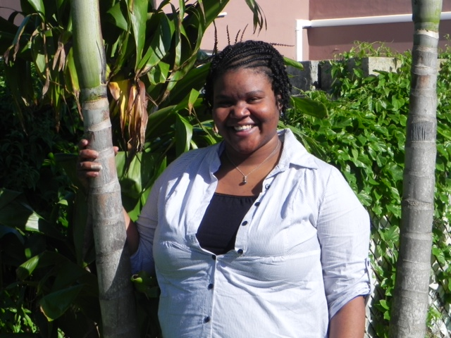
Jonea Paynter, ‘06
Fourth Student Research Day BA (Psych)
My undergraduate thesis (and thus what I presented at Student Research Day) was on the link between math and language abilities in children.
Continuing in the vein of Developmental Psychology, I went onto pursue my Master's of Arts degree in Counselling Psychology at Trinity Western University in British Columbia. My master's thesis was on Identity Development in Bermudian Female Adolescents.
Since graduating from there in 2008 I have moved back home to Bermuda. I currently work as a Family Counsellor at a Community Organization.

Slide 20
While I have the opportunity I just want to wish "Good Luck" and "Blessings" to all of the 2012 participants in Student Research Day. You are on a fantastic journey and I hope that your research process is rewarding and enjoyable no matter what the final results of this day might bring. (Jonea Paynter, ‘06)
What Alumni Have to Say?

Slide 21
Silvia Fleuren, ‘07
Fifth Student Research Day BSc (HNu)
Since graduating with my Advanced Major in 2007, I completed a Master of Applied Human Nutrition from MSVU in Halifax (2009).
I worked for Capital Health for a year as a clinical dietetic technician, before returning to teach at StFX in 2010. I am currently advising my own Advanced Major student (and have encouraged her to participate in SRD as well) - so things have come full circle in that regard!

Slide 22
What I can say about the experience is that it truly helped to develop my confidence in presenting my research in a format similar to an academic conference, and allowed me to share my interests with students and faculty in other academic areas beyond the Human Nutrition department, and I was able to learn about the other research done on campus from my fellow honours/advanced major students presenting that day. I'm very proud that my poster is still on display and has helped prompt further research in the form of honours theses from students since I graduated. (Silvia Fleuren, ’07)
What Alumni Have to Say?

Slide 23
Matt Boland, ‘07
Eighth Student Research Day BBA
Degrees:
BBA (Honours) - StFX (2007)
MBA - Memorial University of Newfoundland (2010)
PhD: Management (Finance) - Carleton University (Current)

Slide 24
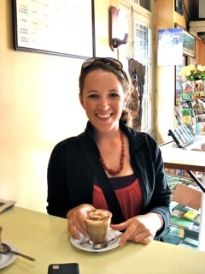
Clare O’Gorman, RN ‘08
Sixth Student Research Day BSc (Nurs)
I am currently in my final semester in the University of British Columbia's Masters of Public Health program, which I entered following a Coady Youth in Partnership placement in Rwanda.
I also work in pediatric care as a community liaison nurse. I continue to apply my undergraduate thesis work in promoting health education through volunteer work with YouthCO, a Vancouver-based HIV and Hep. C community organization, and in public health knowledge translation on my blog www.infectiousideas.ca.

Slide 25
Student Research Day at StFX was a valuable experience that sparked my interest and built my confidence in participating in both empirical and applied research, which I have carried with me through various positions and placements, whether academic or not. (Clare O’Gorman, ’06)
What Alumni Have to Say?

Slide 26
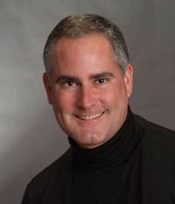
Andy Hirt, ‘08
Fifth Student Research Day BA (Celt)
I'm writing my thesis. I just finished a book "The Celtic Lyre" which is a music book reprint from 1885. I used the theme in my research at StFX when I did the re-write. I found the natural scale all over the music. Remind me to send you the copy of the intro and a few music examples. The book should be printed and launched by the end of March.
I'm a Ph.D. candidate at the University of Otago in New Zealand. I was the first recipient of the international scholarship programme (full tuition and stipend). I am due for submission in about 6 months.

Slide 27
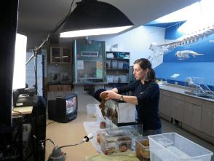
Kelly Cement, ‘08
Sixth Student Research Day BSc (Bio)
In 2008, I presented at Student Research Day on my honours research was completed under the supervision of Dr. David Garbary (Biology) and the poster I presented was titled "Air bladder repair in the intertidal seaweed, Ascophyllum nodosum”.
Once graduating from StFX in 2008, I moved to BC and have been employed ever since by the Bamfield Marine Sciences Centre, located on the west coast of Vancouver Island. I did a brief stint as a field assistant (studying juvenile rockfish), but when the project was over I turned to teaching for the marine centre's Public Education Program. Public Education Programs teach marine biology to students of all ages through hands-on labs and field trips.
As an instructor, I lead all sorts of educational beach trips, boat trips, and classroom activities designed to engage students in various topics in biology and ecology. For schools that are unable to visit the Bamfield Marine Sciences Centre, I also participate in the BMSC Live program, which involves connecting with classrooms through videoconferencing technology.

Slide 28
The only reason I was able to get this 'dream job', as I consider it, is because of the opportunities I had at StFX. My participation in Student Research Day helped me build valuable public speaking and networking skills (I used to think public speaking was absolutely terrifying), and I am extremely grateful for the additional opportunities StFX provided me, such as working in a professor's lab, and helping out as a biology lab demonstrator. These were all incredibly valuable experiences that helped lead me to my current profession. I have gone on to gain many more valuable life skills since leaving StFX, though have not yet pursued additional degrees beyond my honours undergraduate. To be honest, it's because I'm having too much fun with my current job to go back to school just yet! (Kelly Cement, ’08)
What Alumni Have to Say?

Slide 29
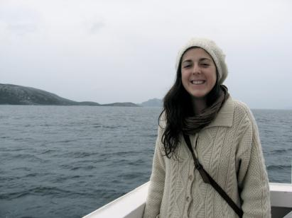
Emily Osmond, ‘08
Eighth Student Research Day BSc (Bio)
Currently studying Medicine (2nd Year) at Memorial University of Newfoundland in St. John’s

Slide 30
I really enjoyed presenting at the Student Research Day. I think it is a great opportunity for students to practice presenting their research and to see all the research that is happening around campus. It allows students to get a taste of what research has to offer. Good luck to all participants! (Emily Osmond, ’08)
What Alumni Have to Say?

Slide 31
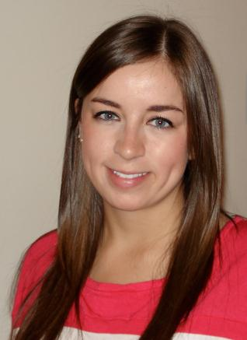
Emma MacDonald, ‘08
Eight Student Research Day BSc (Bio)
After graduation, I began my graduate studies at Ryerson University in Toronto. I received my Masters of Arts in Clinical Psychology in October of 2011. I'm currently in the first year of my PhD studies, also in Clinical Psychology at Ryerson University.

Slide 32
Having graduated from X almost three years ago, I truly appreciate the unique opportunities for X students. Events like the StFX Student Research Day are a great way for students to showcase their work, and also to learn about other research being conducted at X. I hope that students continue to take advantage of this excellent event each year! (Emma MacDonald, ‘08)
What Alumni Have to Say?

Slide 33
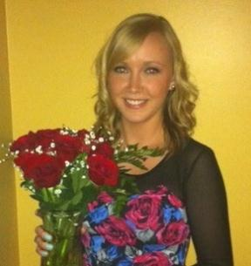
Stephanie Fage, ‘09
Seventh Student Research Day BA (Psych)
I am currently completing my Master of Science at Dalhousie University in Human Communication Disorders, Speech-Language Pathology.
I thoroughly enjoyed my time at StFX and highly value the research experience I was able to gain while completing my undergraduate degree.

Slide 34
Have fun at Student Research Day and congratulations on all of your hard work! (Stephanie Fage, ’09)
What Alumni Have to Say?

Slide 35
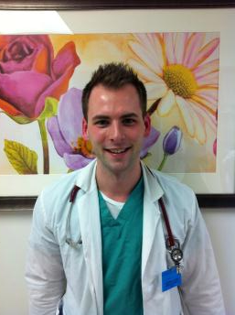
Mitchell Clark, ‘09
Seventh Student Research Day BSc (Bio)
I'm in my 4th year of medical school in New York City and I'm going into Gyn Surgery.

Slide 36
I participated in 2009 and research day gave me the opportunity to display my hard work and research to my peers and colleagues while gaining valuable presentation skills I've carried on into my professional career. Hope you have a successful research day this year and thanks so much for all your hard work to make this event possible. (Mitchell Clark, ‘09)
What Alumni Have to Say?

Slide 37
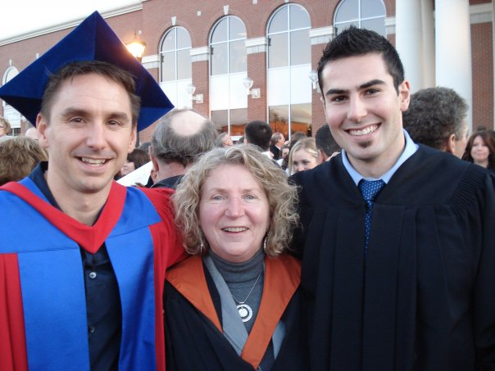
Andrew Adamczyk, 09
Seventh Student Research Day BSc (HKin)
Degrees achieved:
Bachelor of Science (Honours) in Human Kinetics, St. Francis Xavier University, 2009; and Master of Science, Dalhousie University (Department of Physiology and Biophysics), 2011
Where am I now:
Presently at the University of Ottawa Medical program projected to graduate in 2015.

Slide 38
I would have to say that the four years I spent at X have been the four best years of my life. It has been where I have have made some of my greatest friends, had some of the most amazing experiences, and developed the skills and knowledge to succeed in this ever evolving society. No matter the next educational endeavour or career paths you decide to choose after leaving StFX, always remember that you are an Xaverian. Be proud and continue to bleed the blue and white. (Andrew Adamczyk, ’09)
What Alumni Have to Say?

Slide 39
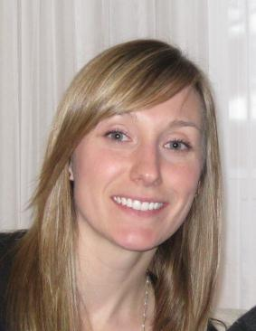
Kendra Read, ‘09
Sixth Student Research Day BSc (HNu)
In November of 2008, I completed the StFX Integrated Dietetic Internship Program and very shortly after gained employment as a Registered Dietitian (RD) at hospital in the Greater Toronto Area where I worked for about one year.
After this time, I was very fortunate to have the opportunity to return to StFX for the 2010 winter semester to lecture for two undergraduate nutrition courses. In the fall of 2010, I returned to Ontario where I continued to work as a clinical RD for eight months.
In the fall of 2011, I returned to Nova Scotia to begin graduate school. At this time, I am working towards the completion of my MSc in Applied Human Nutrition at Mount Saint Vincent University in Halifax, NS. While I am studying I am also working part-time as a Research Assistant with the Applied Research Collaborations for Health team as well as with the Community University Research Alliance (CURA), Activating Change Together for Community Food Security.

Slide 40
The StFX Student Research Day provided me with a great opportunity to share my undergraduate thesis work with the StFX community. The research day is a great way to communicate your research findings to others and learn about other research activities happening on campus. (Kendra Read, ‘09)
What Alumni Have to Say?

Slide 41
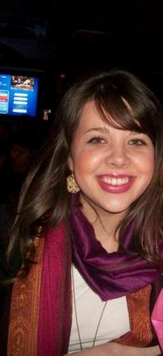
Kaitlyn Dolimount, ‘10
Eighth Student Research Day BSc (Psych)
Currently, I am attending the University of Maine in Presque Isle receiving my Post-Baccalaureate Teacher Certification degree (i.e., my BEd).
I plan on teaching in elementary (K-8) schools upon my graduation in December, 2012.
I work part time for the New Brunswick Department of Education as a tutor for students who are unable to attend public school for a variety of reasons.

Slide 42
Almost two years after my graduation, my time at X still holds some of my most treasured memories. The coveted ring on my right hand serves as a constant reminder of the amazing "X-perience" I had and I take advantage of every opportunity I get to praise and brag about StFX! Enjoy it! Time flies when you're having the time of your life! (Kaitlyn Dolimount, ‘10)
What Alumni Have to Say?

Slide 43
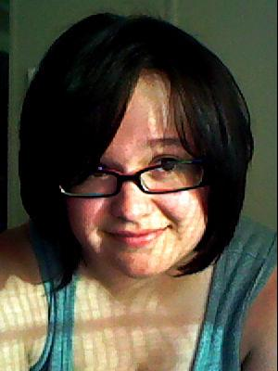
Carole Perry, ‘11
Ninth Student Research Day BA (Anth)
Current occupation:
I am currently between jobs, but I did have a casual position with the Agent Orange Processing Centre within Veterans Affairs Canada.
Degrees achieved (or in process):
Although I cannot tell you of any future plans as of yet, I can tell you that I graduated from StFX with a Bachelor of Arts degree in Anthropology and with First Class Honours.

Slide 44
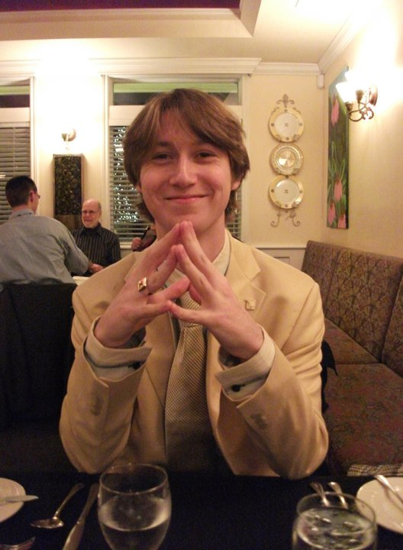
Max Hébert, ‘11
Ninth Student Research Day BA (Psych)
Upon graduating from StFX with an Honours degree in Psychology I went on to enter graduate studies in clinical psychology at Concordia University in Montreal.
I am currently in the first year of my Masters degree. I am now designing a research study investigating language processing in younger and older adults using neuropsychological measurement techniques.

Slide 45
Student research day is an excellent experience to orient young researchers to the conference presentation environment. The skills needed to effectively prepare and present a summary of a year's worth of research are invaluable. Any student working towards a career in research can benefit from the experiences of student research day. (Max Hébert, ‘11)
What Alumni Have to Say?

Slide 46
A very special thank you to all Student Research Day alumni for their updates and reflections!
All the best to the Tenth Annual Student Research Day Participants!
Hail & Health!

