Slide 1
Prelude
Some Microsoft Goodies
Bernard Liengme
bliengme@stfx.ca

Slide 2
But first some non-science!
Daughter: The tires in my new car are filled with nitrogen.
Me: Why?
D: Then the pressure does not change as much with temperature.
Me: <expletive deleted>
Proponents of nitrogen say it eliminates the moisture and that, because nitrogen molecules are bigger than oxygen molecules, which escape over time through the sidewall, nitrogen-filled tires will maintain their pressure longer.

Slide 3
How a microwave oven works From the Discovery Channel
The electromagnetic radiation makes the water molecules vibrate.
This vibration gives rise to friction as molecules rub against each other
So heat is produced.
The phlogiston theory rides again !
More explitives to delete

Slide 4
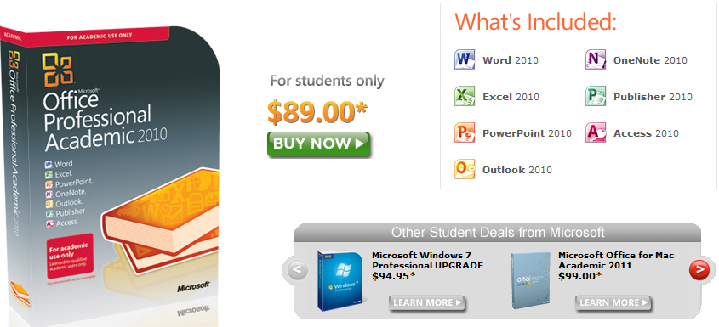
Microsoft Store Student Pricing
http://www.microsoft.com/student/office/en-ca/default.aspx

Slide 5
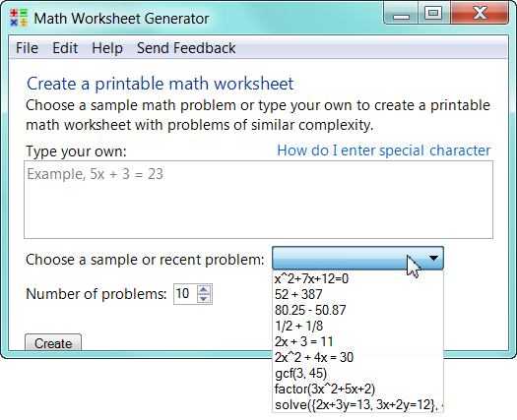
Math worksheet generator
http://www.educationlabs.com/projects/MathWorksheetGenerator/Pages/default.aspx
Generates a Word doc
Last page has the answers!
Great for teachers or those helping younger siblings

Slide 7
Microsoft Word Math Add-in
http://www.microsoft.com/download/en/details.aspx?id=17786
calculate numerical results
plot graphs in 2D and 3D
solve equations or inequalities
simplify algebraic expressions
All within a Word or One Note document

Slide 8
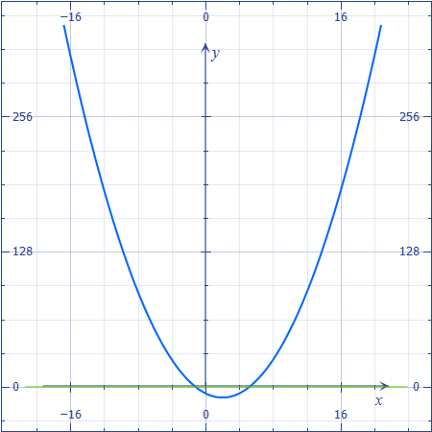
Video of Word Math Add-in
Click me!

Slide 9
Microsoft Mathematics 4 A software graphics calculator
Mathematics 4 (Msetup_X64.exe or Msetup_X86.exe)
http://www.microsoft.com/download/en/details.aspx?id=15702
Teaching Guide: http://download.microsoft.com/download/D/F/0/DF087781-EDEF-45E1-9FAA-18FE7CD1E7E3/microsoft%20mathematics_teacherguide.pdf
Movie time

Slide 10
Microsoft Word Chemistry Add-in
http://research.microsoft.com/en-us/projects/chem4word/
Word Chemistry Formatting Add-in
http://spectrum.troy.edu/~cking/ChemFormat/
Separate version for Office 2010, 2007, 2003 …. And separate add-ins for each product: Word, PowerPoint, Excel

Slide 11
And into the cloud….
Windows Live
This is the email client in Windows 7
But it is more….
SkyDrive is a place where you can store up to 25 GB of files; get at them any time, anywhere. Save place to store. Handy when you are away from your desk (your campus) and need a file.
Widows Live Mesh
I keep a number of folder synched on three computers – main desktop, laptop and back-up desktop. Not sure if you can synch your university H drive.

