Slide 1
GI Disturbances
By Janelle Steele & Katie Smith

Slide 2
Objectives
To understand the A & P of the small bowel as it relates to Inflammatory Bowel Disease (IBD), Irritable Bowel Syndrome (IBS), Diverticulitis and Celiac Disease.
To understand the differences between Crohn’s Disease, Ulcerative Colitis and Celiac Disease.
Nursing implications associated with Inflammatory Bowel Disease (IBD), Irritable Bowel Syndrome (IBS), Diverticulitis and Celiac.
Treatment options for individuals with Inflammatory Bowel Disease (IBD), Irritable Bowel Syndrome (IBS), Diverticulitis and Celiac.
Nutritional management for individuals with Inflammatory Bowel Disease (IBD), Irritable Bowel Syndrome (IBS), Diverticulitis and Celiac .

Slide 3
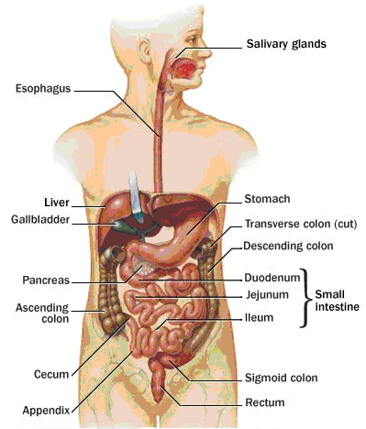
Anatomy & Physiology of the Gastrointestinal System
GI tract: breakdown, absorption
and elimination
  Upper potion
  the mouth
  esophagus
  stomach
  Lower portion
  small intestine
  large intestine
  rectum
  anus.
(Day et al., 2010)

Slide 4
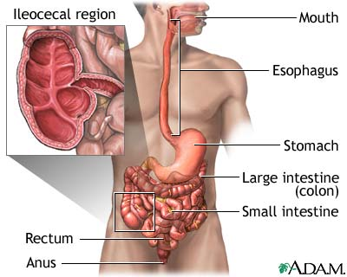
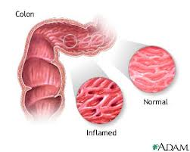
Inflammatory Bowel Disease
IBD refers to two chronic inflammatory GI disorders: Crohn’s disease and Ulcerative Colitis, both cause inflammation and ulcerations of the intestine.
Two Types:
  Crohn’s: usually affects the intestines.
  Ulcerative Colitis: usually affects the large intestine.
Statistics:
200,000 Canadians have IBD
15-30 years of age at highest risk.
gender nonspecific.
(Day et al., 2010)

Slide 5
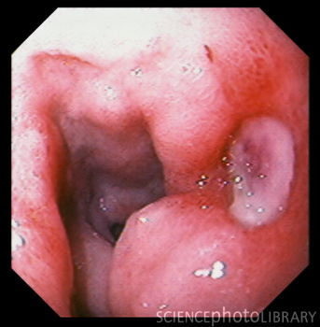
Inflammatory Bowel Disease: Complications
Ulcers: chronic inflammation can lead to open sores within the digestive tract.
Fistulas: when an ulcer forms and extends completely through the intestinal wall.
Anal fissures: crack or cleft in the anus or skin where infection occurs.
Malnutrition: difficulties eating and absorbing nutrients.
Other problems:
  Arthritis
  Kidney and gallstones
  Inflammation of eyes and skin
(Day et al., 2010)

Slide 6
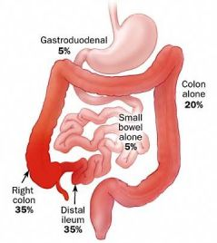
Crohn’s Disease: Etiology & Pathophysiology
Chronic disorder that causes inflammation of the GI tract, most commonly affecting the small intestine.
Transmural; affecting all layers of the mucosa.
Begins with edema and thickening of the mucosa.
Ulcers appear on the inflamed mucosa, causing fistulas and fissures.
Scaring, thickening and narrowing of the GI tract.
Statistics:
Usually diagnosed in adolescents
Prevalence has risen in the past 30 years.
seen more in smokers
(MFMER, 2011 ; Day et al., 2010; CCRC, 2008; CCFC, 2008 ; Mahan & Escott-Stumop, 2004;)

Slide 7
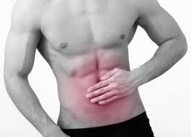
Crohn’s Disease: Clinical Manifestations
Persistent diarrhea
Loss of appetite & weight loss
May have rectal bleeding
Cramping abdominal pain
Steatorrhea
Fatigue
Fever
Complications
Bowel obstruction
Sores of ulcers
Fistulas
Malnutrition
(CSIR, 2012; CCFC, 2008)

Slide 8
Crohn’s Disease: Diagnosis
Health history: Onset, associated symptoms, pain, stool, & rectal bleeding.
Blood tests: anemia or infection and certain antibodies
Fecal occult blood test: looking rectal bleeding.
Stool sample : presence of white blood cells.
Colonoscopy : visualize and collect biopsy.
Flexible sigmoidoscopy : examine sigmoid colon.
Barium enema : evaluate large intestine with x-ray.
X-ray : rule out toxic megacolon.
CT scan : assess for complications and amount of infection.
MRI : diagnosis and management.
Capsule endoscopy : all other diagnostics are negative.
Double – balloon endoscopy : still questioning diagnosis.
Small bowel imaging : locate narrowing or inflammation.
(CSIR, 2012; MFMER, 2011; CCFC, 2008)

Slide 9
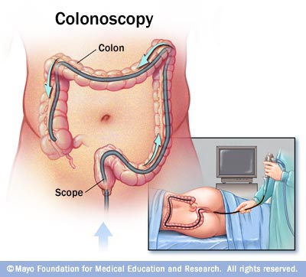
Colonoscopy
A procedure used to see inside the colon and rectum
Used to investigate intestinal signs and symptoms.
Preparation:
  Bowel prep to empty the bowel.
  No solid food the day before
  Laxative or enema kit
  Adjust medications
Postoperative:
  Hour to recover
  Blood with first BM
  When to seek medical care
    Severe abdominal pain, fever, dizziness, weakness, bloody BM’S
http://www.youtube.com/watch?v=rSXTIzqWc7s
(NIDDK, 2011; MFMER, 2011)

Slide 10
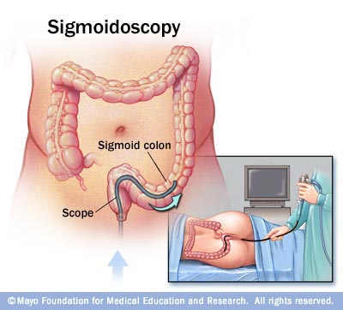
Flexible Sigmoidoscopy
A procedure used to evaluate the part of the large intestine and investigate signs and symptoms.
Preparation:
  No solid foods
  NPO after midnight
  Laxative or enema kit
  Adjust medications
What to expect:
  Usually does not require sedation or pain medication.
  May feel abdominal cramping or urge to push.
  Ability to take biopsies .
  Takes about 15 minutes.
(NIDDK, 2011; MFMER, 2011)

Slide 11
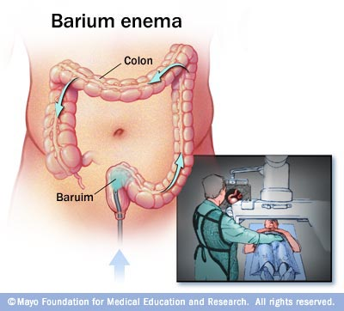
Barium Enema
A special X-ray used to detect changes or abnormalities in the large colon and part of the small intestine.
Single-column: allows visualization of silhouette , shape and condition of colon.
Air-contrast: Air expansion improves the quality of X-ray images.
During exam:
  No sedation necessary.
  Side lying position.
  May manipulate the colon manually.
  Enema tube is inserted with a barium bag.
After exam:
  May expel additional barium and air with BM.
  Drink plenty of fluids, laxative may be required.
(NIDDK, 2011; MFMER, 2011)

Slide 12
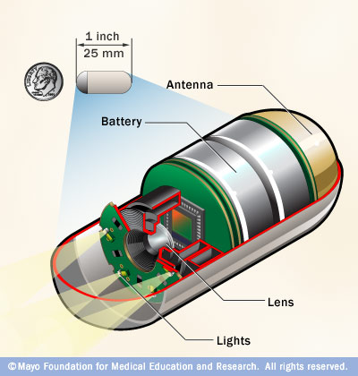
Capsule Endoscopy
A procedure that uses a tiny wireless camera to take pictures of your digestive tract.
Preparation
  Stop eating for 12 hours before.
  Stop or delay certain medications.
  Plan to take it easy for the day.
During the test
  Wear a recorder with a special belt.
  Avoid strenuous activity.
  May or may not be able to go back to work.
After the procedure
  Contact doctor if capsule not eliminated within two weeks
  Complete after 8 hours, camera eliminated within hours
  After 2 hours may resume clear liquids.
(MFMER, 2011)

Slide 13

Crohn’s Disease: Treatment
  Anti-inflammatory drugs:
    5-Aminosalicylates
    Corticosteriods
  Immune system suppressors:
    Methotrexate
    Cyclosporine
  Antibiotics:
    Metronidazole
    Ciprofloxacin
  Anti-diarrheals:
    Metamucil
    Citrucel
  Pain relievers:
    Acetaminophen
(MFMER, 2011 ; CCFC, 2008)
Notes:
.

Slide 14
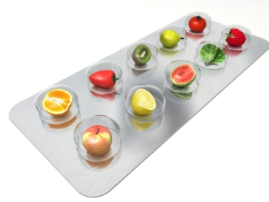
Crohn’s Disease: Medical Nutrition Therapy
Diet changes:
  Limit dairy products
  Low fat foods
  Limit fiber
  Avoid problem foods
  Eat small meals
  Drink plenty of fluids
  Multivitamins
Enteral and Paraenteral Nutrition
  Allows for bowel rest
  Reduces inflammation short term
  Used pre-op and when medications fail
(MFMER, 2011)

Slide 15

Crohn’s Disease: Non-Pharmacologic & Alternative Therapies
Stress
  Can worsen or precipitate flare ups.
Exercise
  Reduces stress
  Relieves depression
  Normalizes bowel function
Relaxation
Other
  Probiotics
  Fish oil
  Acupuncture
(MFMER, 2011)

Slide 16
Crohn’s Disease: Nursing Considerations
Teaching & Education
  Stress management techniques
  Medication therapies
  Diet management & exercise
  Diagnostic testing and procedures
Support
  Understanding the disease
  Body image
Collaborate
  Dietitian
  Gastroenterologist & Surgeon
  Smoking cessation programs

Slide 17
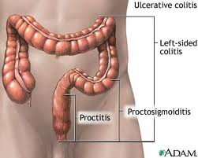
Ulcerative Colitis: Etiology & Pathophysiology
Affects the superficial mucosal layer resulting in inflamed mucosa with small ulcers that cause bleeding.
Classifications:
Extensive colitis – extends to the hepatic flexure.
Proctosigmoidsitis - extends to the rectosigmoid junction.
Left-sided colitis – extends to the splenic flexure.
Pancolitis – extends from the rectum to the ceum and involves the entire colon.
Proctitis - confined in the rectum.
(Day et al., 2010, Sephton, 2009)

Slide 18
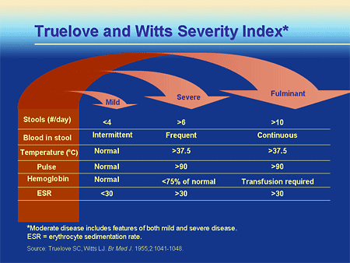
Ulcerative Colitis: Clinical Manifestations
Symptoms:
  Diarrhea
  LLQ abdominal pain
  Intermittent tenesmus
  Rectal bleeding
    Pallor
    Anemia
    Fatigue
Classifications:
  Mild
  Severe
  Fluminant
  (Day et al., 2010, Sephton, 2009)

Slide 19
Ulcerative Colitis: Diagnosis
CBC – ESR, C-reactive protien, WBC, Plts, LFT, Albumin
Series of 3 stools sent to microbiology, C & S, and for c. difficile .
X-ray - assess for toxic megacolon and perforation.
Sigmoidscopy & Colonoscopy– assess extent and severity of the disease.
CT, MRI & Ultrasound – identify abscesses and peritoneal involvement.
Nursing assessments:
  Tachycardia
  Hypotension
  Tachycardia
  Pallor
Fever
Bowel sounds
Distention
Tenderness
(Day et al., 2010, Sephton, 2009)

Slide 20
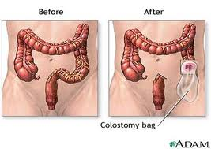
Ulcerative Colitis: Treatment
Medical management:
  ASA -
  Corticosteriods -
  Immunosupressive drugs –
  Methotrexate –
  Anti-TNF therapy -
Surgery:
  Creation of colostomy
  One stage
  Two stage
  Three stage
(Day et al., 2010, Sephton, 2009)

Slide 21
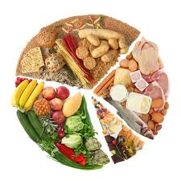
Ulcerative Colitis: Medical Nutrition Therapy
Diet modification:
  Low residue
  High protein diet
  Initially include excess fibre
  Smaller frequent meals
Exacerbations due to:
  Increase sucrose intake
  Lack of fruit and vegetable intake
  Low intake of dietary fibre
  Altered omega 3 fatty acid ratios
  Overall poor quality diet
(Day et al., 2010, Sephton, 2009)

Slide 22
Ulcerative Colitis: Nursing Considerations
Teach & Educate
  Early recognition
  Monitor hydration and keep food journal
  Stool chart
  Weight monitoring
Support
  Emotional support
Collaborative Care
  Infection control nurse
  Dietitian
  Gastroenterologist & surgeon
(Day et al., 2010, Sephton, 2009)

Slide 23
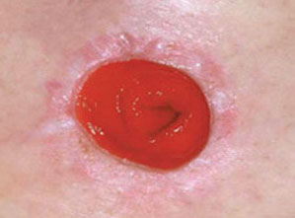
Ostomies’s
A stoma (ostomy) is an artificial, surgically created opening into the abdominal wall to allow exit of feces and urine.
Colostomy: formed through colon (large bowel)
  Pass flatus & soft formed feces.
    Permanent end: removal of anus, anal canal, rectum and some of the distal colon.
    Loop: formed in transverse colon, 2 ends are brought to surface.
Ileostomy: formed in ileum (small bowel)
  Pass flatus & loose porridge-like stool.
    Permanent end: removal of entire colon.
    Loop: creation of stoma after anastomosis.
(Burch, 2011 ; Day et al., 2010)

Slide 24
Inflammatory Bowel Disease: Nursing Diagnosis
Diarrhea related to the inflammatory process
Acute pain related to increased peristalsis and GI inflammation.
Fluid volume deficit related to anorexia, nausea and diarrhea
Imbalanced nutrition: less than body requirements related to dietary restrictions, nausea, and malabsorption
Activity intolerance related to fatigue
Anxiety
Ineffective coping related to repeated episodes of diarrhea
Risk for impaired skin integrity related to malnutrition and diarrhea
Knowledge deficit

Slide 25
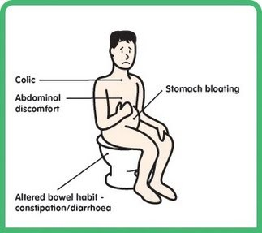
Irritable Bowel Syndrome
Common disorder based on a presentation of signs and symptoms.
- intermittent to continuous, mild to severe.
- Abnormal pattern in bowel elimination including constipation, diarrhea or both.
- abdominal pain, feeling of fullness, gas, or bloating.
Clients have a normal bowel structure with no inflammation.
Abnormal function of motility or peristalsis due to:
- neuroendocrine disorders
- vascular disturbances
- metabolic disturbances
- infection
- irritation
(Day et al., 2010)

Slide 26
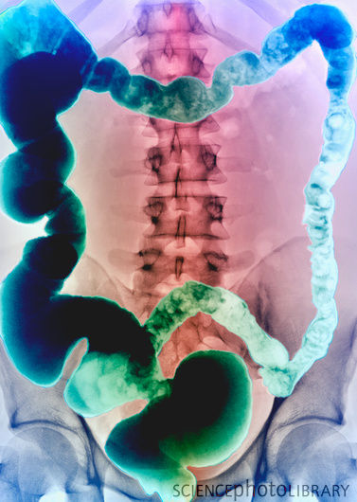
Irritable Bowel Syndrome: Diagnosis
No definitive diagnosis, a symptom based diagnosis once other structural disorders have been ruled out.
Symptoms must be present for a minimum of 3 days a month for 3 consecutive months.
Procedures: looking for a spasm, distention or mucus accumulation in the intestine.
stool studies
x-rays & contrast x-rays
barium enema
colonoscopy
(Day et al., 2010)

Slide 27
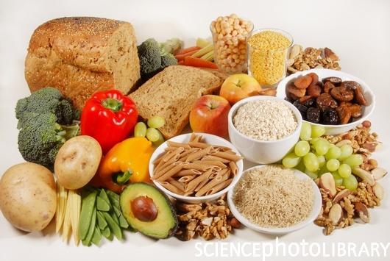
Irritable Bowel Syndrome Treatment
There is no medical treatment, although there are medications used to treat symptoms such as:
  anticholinergics
  antidiarrheals
  bowel aids
  some cases, antibiotics
Nutritional Management:
restrict foods then gradually increase.
avoid large meals
increase fibre.
avoid foods that stimulate the bowel
- caffeine - spicy foods
- fried foods - alcohol
- carbonated drinks
(Day et al., 2010)

Slide 28

Irritable Bowel Syndrome: Nursing Considerations
Support:
  tests involved & psychological support.
Educate:
  alcohol and smoking cessation
  avoiding triggering foods
  eating regular small meals
Collaborative Care:
  Dietitians
  Gastroenterologist & surgeons
(Day et al., 2010)

Slide 29
Diverticulitis
Diverticulum: a “saclike herniation of the lining of the bowel that extends through a defect in the muscle layer.” (Day et al., 2010, pg. 1167).
Diverticulosis: when multiple diverticuli exists.
Diverticulitis: results when food and bacteria retained in a diverticumulum produce infection and inflammation that can impede drainage and lead to perforation or abscess formation.”
The cause is unknown. Low fiber and high fat diet may cause sac formation.
Symptoms include: acute onset of mild to severe pain in the lower left quadrant, accompanied by nausea, vomiting, fever, and chills.
(Day et al., 2010)

Slide 30
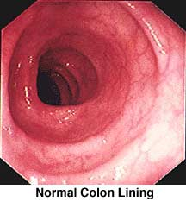
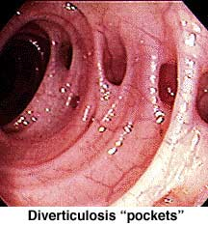
Diverticulitis: Diagnosis
CBC: shows an elevated WBC.
Colonoscopy: shows extent of disease and biopsy is completed.
CT: confirms diagnosis.
(Day et al., 2010)

Slide 31
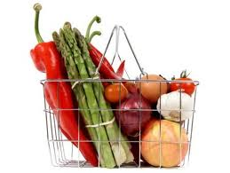
Diverticulitis: Treatment
Nutritional Management
  high fiber
  low fat
  symptomatic: clear liquid diet
Medical Management
  antibiotics
  laxatives
  stool softeners
  hospitalization of
  immunocompromised.
  surgical considerations
Complications
  perforation
  peritonitis
  hemorrhage
  obstruction
(Day et al., 2010)

Slide 32
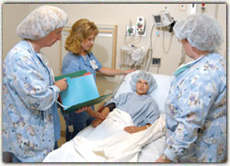
Diverticulitis: Nursing Considerations
Education and Teaching
  Understanding the disease
  Avoid high fat foods
  Increase fiber intake
  Drink plenty of fluids
  How to manage attacks
  When to seek health care
Surgical nursing considerations:
  Preoperative teaching
  Postoperative teaching
  Self image
(Day et al., 2010)

Slide 33
Celiac Disease: Gluten-sensitivity enteropathy
Is a autoimmune medical condition in which damage to the mucosa layer of the small intestines occurs following ingestion of a substance called gluten.
Statistics:
  1 in 200 Canadians; 330,000 Canadians in total
  Increased risk with genetic predisposition
  Often misdiagnosed
  Is more common in Caucasians
  More frequent in women
  Rates have nearly doubled in last 25 years
  More commonly diagnosed in children; 73,000 in total
  50% of clients have few or no obvious symptoms
(CSIR, 2012; Canadian Digestive Health Foundation, 2012; CCA, 2011; MFMER, 2011; Day et al., 2010; PubMed Health, 2010; Mahan & Escott-Stumop, 2004).

Slide 34
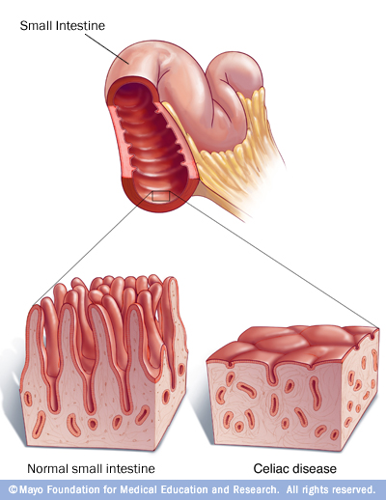
Celiac Disease: Etiology/Pathophysiology
When gluten in ingested it creates a systemic immune and inflammatory response that damages and flattens the intestinal villi.
This causes malabsorption difficulties of essential macro and micronutrients.
Affects primarily the proximal and midpoints of the small intestine, and possibly the distal portions.
It takes only one molecule of gluten to trigger the destructive mucosal response.
(Canadian Society of Intestinal Research, 2012; MFMER, 2011; Mahan & Escott-Stumop, 2004)

Slide 35
Celiac Disease: Clinical Manifestations
Common Symptoms:
  Chronic diarrhea; steatorrhea and malodorous stools
  Constipation
  Weight loss or poor weight gain
  Delayed puberty/ missed menstrual periods
  Breathlessness
  Fatigue
  Abdominal cramping and bloating
  Irritability or apathy
  Easily bruised
  Muscle cramps and joint pain
  Lactose intolerance
  Nausea and vomiting
  (Canadian Digestive Health Foundation, 2012; Canadian Society of Intestinal Research, 2012; Canadian Celiac Association, 2011; PudMed Health, 2010; Mahan & Escott-Stumop, 2004)

Slide 36
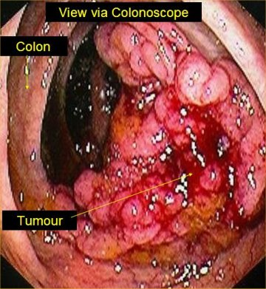
Complications of Celiac Disease
Malnutrition
  Malabsorption
  Growth delay
Osteoporosis
  Calcium & Vitamin D deficiency
Lactose Intolerance
  Abdominal pain
  Diarrhea
Cancer
  Intestinal lymphoma
  Bowel cancer
Neurological
  Seizures
  Peripheral neuropathy
  (MFMER, 2011)

Slide 37
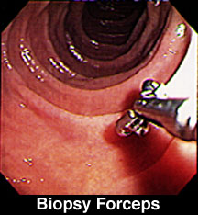
Celiac Disease: Diagnosis
Screening
  Blood tests
Endoscopy
  Gold standard
  Internal mucosa biopsy
Capsule endoscopy:
  Examines entire small intestine
Both biopsy and blood test results may be difficult to interpret if client has been on a gluten free diet.
(CSIR, 2012; Canadian Digestive Health Foundation, 2012; MFMER, 2011; Canadian Celiac Association, 2011; PubMed, 2010. Mahan & Escott-Stumop, 2004).

Slide 38
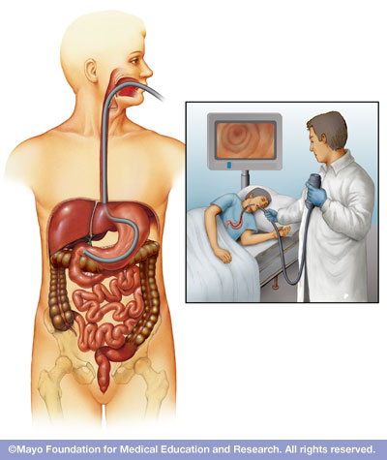
Endoscopy
A procedure used to visually examine the upper digestive system with a tiny camera.
Preparation
  Fast 8 hours before
  Stop taken medications
During
  Lie down on backside.
  Receive a sedative IV.
  Tube inserted through the mouth, feel some pressure
After procedure
  Stay for an hour to recover and will need transportation
  May experience mild uncomfortable signs and symptoms
  (MFMER, 2012)

Slide 39
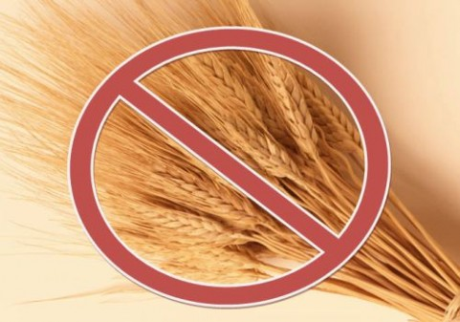
Celiac Disease: Treatment
Medical Therapy:
  Corticosteroids (ie: prednisone)
  Azathioprine
  Cyclosporine
  Anti-inflammatory
  Gluten free diet is the first line of treatment, it may take months or years for the intestinal mucosa to heal.
(PubMed, 2010; Mahan & Escott-Stumop, 2004).

Slide 40
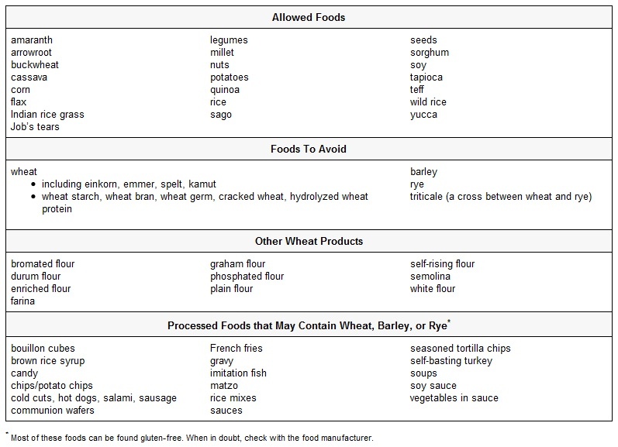
Celiac Disease: Medical Nutrition Therapy

Slide 41
Celiac Disease: Nursing Considerations
Teach & educate:
  How to read food labels
  Avoid gluten containing products
  Vitamin and mineral supplementation
Support:
  Financial considerations
  Collaboration:
  Dietitian
  Community Resources

Slide 42
Celiac Disease: Nursing Diagnosis
Relieving pain
Maintaining normal elimination patterns
Maintaining fluid intake
Maintaining optimal nutrition
Promoting rest
Reducing anxiety
Enhancing coping measures
Preventing skin breakdown
Monitoring and managing potential complications

Slide 43
Gastrointestinal Disorders: Summary
A & P of the small bowel as it relates to Inflammatory Bowel Disease (IBD), Irritable Bowel Syndrome (IBS), Diverticulitis and Celiac Disease.
The differences between Crohn’s Disease, Ulcerative Colitis and Celiac Disease.
Nursing implications associated with Inflammatory Bowel Disease (IBD), Irritable Bowel Syndrome (IBS), Diverticulitis and Celiac.
Treatment options for individuals with Inflammatory Bowel Disease (IBD), Irritable Bowel Syndrome (IBS), Diverticulitis and Celiac.
Nutritional management for individuals with Inflammatory Bowel Disease (IBD), Irritable Bowel Syndrome (IBS), Diverticulitis and Celiac .

Slide 44
Case Study
Mary is a 23 year old female experiencing diarrhea, abdominal pain, fatigue and low appetite.
Mary is going for a colonoscopy, how are you going to help her prepare for this procedure?
Mary is given the diagnosis of Crohn’s disease, how would you help her manage this condition?
When would you advise Mary to seek health care in relation to her condition?
What other nursing implications would you include in assisting Mary?

Slide 45
Questions/Comments

Slide 46
References
Beyer, P. L. (2004). Medical nutrition therapy for lower gastrointestinal tract disorders. In Mahan, L. K., & Escott-Stump, S. (11th Ed.), Krause’s food, nutrition, & diet therapy (p. 705-737). Philadelphia: Saunders.
Burch, J. (2011). Resuming a normal life: holistic care of the person with an ostomy. British Journal of Community Nursing, 16(8), 366-373.
Canadian Celiac Association. (2011). Celiac Disease. Retrieved from http://www.celiac.ca/index.php/about-celiac-disease-2/symptoms-treatment-cd
Canadian Digestive Health Foundation. (2012). Celiac Disease. Retrieved from http://www.cdhf.ca/digestive-disorders/celiac.shtml
Canadian Society of Intestinal Research. (2012a). Celiac Disease. Retrieved from http://www.badgut.org/information-centre/celiac-disease.html
Canadian Society of Intestinal Research. (2012b). Crohn’s Disease. Retrieved from http://www.badgut.org/information-centre/crohns-disease.html
Crohn’s & Colitis Foundation of Canada (CCFC). (2008). The Burden of IBD in Canada. Retrieved from http://www.ccfc.ca/atf/cf/%7B282e45d9-a03a-49d1-883c 39f4feaf7246%7D/BIBDC%20FINAL%20OCTOBER%2029TH%20EN.PDF
Day, R. A., Paul, P., Williams, B., Smeltzer, S. & Bare, B. (2007). Canadian textbook of medical surgical Nursing (1st Canadian Ed.). Philadelphia: Lippincott Williams & Watkins.
Mayo Foundation for Medical Education and Research. (2011a). Inflammatory Bowel Disease (IBD). Retrieved from http://www.mayoclinic.com/health/inflammatory-bowel-disease/DS01195.
Mayo Foundation for Medical Education and Research. (2011b).Crohn’s Disease. Retrieved from http: //www.mayoclinic.com/health/crohns-disease/DS00104.
Mayo Foundation for Medical Education and Research. (2011c). Celiac Disease. Retrieved from http://www.mayoclinic.com/health/celiac-disease/DS00319/DSECTION=causes.
National Institute of Diabetes and Digestive and Kidney Diseases (2011). Crohn’s Disease. Retrieved from http://digestive.niddk.nih.gov/ddiseases/pubs/crohns/index.aspx.
PubMed Health. (2010). Celiac Disease. Retrieved from http://www.ncbi.nlm.nih.gov/pubmedhealth/PMH0001280/.
Sephton, M. (2009). Nursing management of patents with severe ulcerative colitis. Nursing Standard, 24, 48-57.

