Slide 1
AMPUTATIONS
Jackie Brown & Shaylynn MacLeod

Slide 2
Objectives
To explore related definitions and statistics, causes, and types of amputations
To learn preoperative and postoperative nursing interventions
To discuss possible complications and their prevention
To learn about wound care, including Figure 8 wrapping
To explore care of the residual limb and types of prostheses
To learn about the rehabilitation process for an amputee
To formulate nursing diagnoses relevant to the nursing care of a client with an amputation
To engage critical thinking skills through a case study

Slide 3
Statistics
185,000 amputations in the US each year
Around 80% of amputees are over the age of 65
80-90% of amputations are caused by PVD
Lower extremity amputation (LEA) = 87% of all amputations performed in the US and Europe
↑↑ complications in LEA for disease-related causes with 50% dying within 5 years of LEA
Notes:
The National Limb Loss Information Center estimates 185,000 amputations are performed/year in the US (Liu, Wiliams, Liu, & Chien, 2010). Approximately 80% of amputees are 65 or older. 80-90% of amputations are caused by peripheral vascular disease (Kelly & Dowling, 2008). Lower extremity amputation is the most common level of amputation, comprising 87% of all amputations in the US and Europe. Those who undergo LEA because of disease-related causes experience an increased risk for complications. In fact, 50% of disease-related LE amputees die within 5 years of their amputation (Liu et al., 2010).

Slide 4
Definitions:
Amputation –removal of part of the body, limb, or part of a limb
Stump – Aka residual limb; part of a limb that remains after amputation
Purpose:
Relieve symptoms
Improve function
Improve QOL
Save life!
Notes:
An amputation is a “removal of a part of the body, a limb, or part of a limb to treat recurrent infection or gangrene in peripheral vascular disease, to remove malignant tumors, and to treat severe trauma” (Mosby, 2009, p. 88). The remaining portion of the limb (if applicable) is called the stump, or residual limb (Mosby, 2009). Amputations are performed to relieve symptoms, improve function, improve QOL, or to save the client’s life (Day et al., 2010).

Slide 5
Reasons for Amputations
Traumatic injury
Progressive arterial disease: often a sequelae of diabetes
Gangrene/infection
Congenital deformities
Chronic osteomyelitis
Malignant tumor
Notes:
By far the most common reason for lower limb amputation is due to foot ulcerations, which occur mostly in people with diabetes.
According to Robinson et al., 2010, of all lower limb amputations, 72% are due to vascular pathologies, and trauma accounts for approximately 7%.
Traumatic injuries are still another a common reason for amputation.
Other causes for amputation are gangrene, congenital deformities, chronic osteomyelitis, and a cancer.

Slide 6
Traumatic Injury
Or partial laceration
requiring surgical
amputation
Can be complete amputation
from an accident
Notes:
Traumatic amputations can be a complete traumatic amputation from an accident, or a partial laceration requiring surgical amputation. It can be due to such injuries as guillotine injuries, crushing injuries, explosive injuries, burns, or frostbite, to name a few.

Slide 7
Progressive Arterial Disease
Often due to Diabetes
Can lead to ulcers that may require amputation
Amputation is four times more likely in diabetics than non-diabetics
Notes:
Progressive arterial disease, which is often a sequelae of diabetes, is the most common cause for amputation. Approximately 15% of people with diabetes will develop a foot ulcer, which may result in amputation. It is four times more likely to occur in diabetics

Slide 8
Gangrene
May require staged amputations
Initially a guillotine amputation is done to remove the necrotic and infected tissue
Sepsis is treated with systemic antibiotics
After the infection is controlled and the patient’s condition has been stabilized, a definitive amputation with skin closure is performed

Slide 9
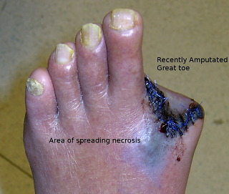

Slide 10
Prevention
Diagnosis and management of diabetes
Thorough foot exam once per year
Drive safely:
Wear your seatbelt
Drive the speed limit
Safety at work if using heavy equipment, saws, explosives, or flammable substances
Notes:
Since diabetes is the number one cause for amputations, early diagnosis and management of diabetes is important.
People who have diabetes, neuropathy, peripheral arterial disease or ischemia should have a thorough foot exam at least once a year to assess sensation, vascular status, skin integrity, foot structure, and biomechanics.
Although traumatic amputations are difficult to prevent, safety during activities can help reduce the number of accidents. First of all, drive safe – wear your seatbelt and drive the speed limit to help lower your risk of car accidents.
Practice safety at work when using heavy equipment, saws, explosives, or flammable substances.

Slide 11
Sites for Amputation
Upper limb:
Forequarter:
Shoulder disarticulation
Above-Elbow: Trans-humeral
Elbow disarticulation
Below-Elbow :Trans-radial
Hand and wrist disarticulation
Partial hand: Trans-carpal
Lower limb:
Hemipelvectomy
Hip disarticulation
Above-knee: Trans-femoral
Knee disarticulation
Below-knee: trans-tibial
Ankle disarticulation
Symes (Modified ankle disarticulation)
Partial foot
Digits

Slide 12
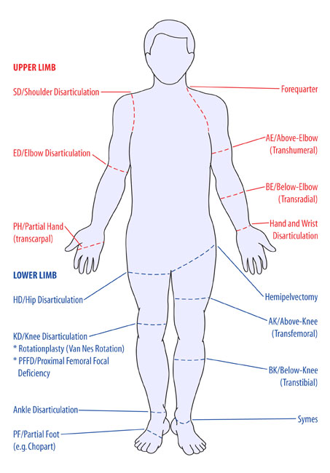
Notes:
Upper limbs:
Forequarter:
Shoulder disarticulation
Above-Elbow - Trans humeral
Elbow disarticulation
Below-Elbow - Trans radial
Hand and wrist disarticulation
Partial hand – Trans carpal
Lower limb:
Hemipelvectomy
Hip disarticulation
Above-knee – Transfemoral
Knee disarticulation
Below-knee – transtibial
Ankle disarticulation
Symes (Modified ankle disarticulation)
Partial foot
(Cathy’s photo)

Slide 13
Types of Amputations
Determined by two factors:
Adequacy of circulation
Functional usefulness such as requirements to use a prosthesis
Objective is to conserve as much extremity length as possible.
Preservation of elbow and knee joints are desired
Below knee amputations are preferred to above the knee
Notes:
The type of amputation is determined by two factors. These are adequacy of circulation and the functional usefulness.
The level of amputation depends mainly on the underlying pathology. Amputation is performed at the most distal point of the extremity that will heal successfully. The circulatory status of the limb is assessed, as muscle and skin perfusion is essential for healing.
This is done by assessing the temperature of skin, hair growth, pulses, capillary filling rate, and bleeding at the operative site as well as the ankle/brachial index and transcutaneous oxygen pressure (TcPO2).
The level of amputation also depends on the functional usefulness that meets the requirements for use of a prosthesis. The objective is to conserve as much extremity length as possible. If possible, below knee amputations preferred to above knee because of the importance of the knee joint and the energy requirements for walking with a prosthetic leg

Slide 14
Preop Interventions
Assess:
Neurovascular and functional status of extremity
In traumatic amputation – function and condition of residual limb, circulatory status and function of unaffected limb
Nutritional status – healing = ↑ protein & vitamin requirements
Psychological status – determine emotional reaction to amputation
Current medications – especially corticosteroids, anticoagulants, vasoconstrictors, vasodilators
Notes:
Before surgical amputation, the nurse must assess the neurovascular and functional status of the affected extremity. In the case of traumatic amputation, the nurse assesses the function and condition of the residual limb as well as the circulation and function of the Unaffected limb. Nutritional status must be evaluated. Wound healing requires a balanced diet with sufficient protein and vitamin intake. Assess current medications. Corticosteroids, anticoagulants, vasoconstrictors, and vasodilators can affect surgical outcome and wound healing. Assessment of psychological status is crucial. This not only determines the emotional reaction towards amputation but also influences progress in rehab (Day et al., 2010). Amputees commonly report anger, sadness, helplessness, frustration, anxiety, and guilt (Liu et al., 2010). Those with traumatic amputation may be at increased risk for depression and PTSD and may use more avoidant coping strategies than those undergoing surgical amputation (Kratz et al., 2010). This is likely due to the unexpected nature of traumatic amputations and the lack of time to psychologically prepare oneself for the changes they will endure. A grief response is normal as patients begin to process their permanent loss and change in body image (Day et al., 2010).

Slide 15
Preop Interventions
Identify & address concurrent health problems
Dehydration, anemia, cardiac insufficiency, chronic respiratory problems, diabetes mellitus
Treat so that client is in best possible condition for surgery
X-rays of extremity in 2 views
Doppler or angiography to determine perfusion
Prepare for client for surgery:
Postop expectations
Psychological preparation
Notes:
The patient must be in as stable a condition as possible in order to withstand the trauma associated with surgical amputation. In collaboration with the physician, the nurse identifies and addresses health problems such as dehydration, anemia, cardiac insufficiency, respiratory problems, and diabetes (Day et al., 2010). The doctor will order x-rays of the extremity to be amputated in 2 views. Doppler exam or angiography determines perfusion of the limb. Client education in the preoperative period includes postop expectations including early ambulation, rehab expectations, risk of complications, and psychological impact of the surgery (Jacobs et al., 2011).

Slide 16
Amputation of Right Leg

Slide 17
Notes:
Incision is made and deepened as far deep fascia all around leg, during the amputation of a right leg.

Slide 18
Notes:
Surgeon dissecting through quadriceps muscles

Slide 19
Notes:
Finger looping beneath nerve to increase tension within it, transected with a scalpel

Slide 20
Notes:
Periosteal elevator is used to scrape bone to prepare it to be cut

Slide 21
Notes:
Surgeon cutting through bone using an amputation saw

Slide 22
Notes:
A portion of leg following the amputation

Slide 23
Notes:
After clearing any blockages from the artery, surgeons close the wound

Slide 24
Notes:
Flaps are re-approximated and trimmed with scissors

Slide 25
Notes:
Allis clamps attaching skin edges to keep wound closed while surgeon prepares to close the wound

Slide 26
Notes:
Clamps are released individually so underlying skin can be closed

Slide 27
Notes:
Surgeon places the last of staples closing the wound

Slide 28
Notes:
Closed wound

Slide 29
Notes:
Wound is dressed to keep it clean and free from post-operative infection

Slide 30
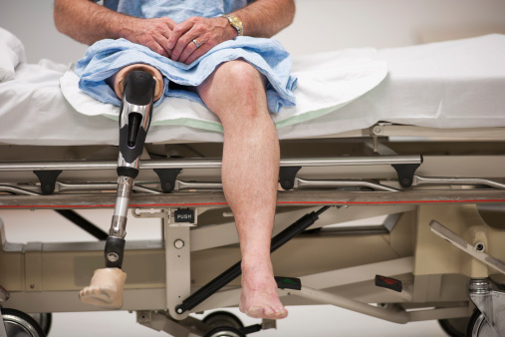
Postop Interventions
Pain relief
Altered sensory perception
Wound care
Accepting altered body image
Resolving grief process
Notes:
Nursing care in the immediate postoperative period are the same as for any surgical procedure – assess and maintain airway, breathing, circulation. Monitor VS. Manage pain. Prevent complications such as atelectasis, DVT, skin breakdown. Monitor for signs and symptoms of hemorrhage (Pullen, 2010). After the immediate postop period, nursing care centers around 5 priorities – pain management, managing altered sensory perception, facilitating wound healing, and helping the patient accept body image and resolve the grieving process associated with limb loss (Day et al., 2010).

Slide 31
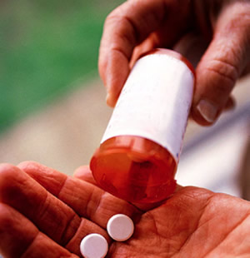
1. Pain Relief
Causes:
Incision
Inflammation
Pressure on bony
prominences
Hematoma
Muscle spasm
Relief:
Opioids
Position change; sandbag on residual limb
Evacuate hematoma
Notes:
Postop pain may be caused by the incision, inflammation, infection, pressure on bony prominences, muscle spasm, neuroma formed when scarred nerve endings cause abnormal firing, or hematoma, which occurs when blood leaves blood vessels, becomes trapped in tissues, and forms a hardened clot (Chapman, 2010; Day et al., 2010; Mosby, 2009). Pain can be managed pharmacologically through the use of opioids. Nonpharmacological interventions may also be effective. Reposition slowly q2h to relieve pressure on bony areas while preventing muscle spasm. In below the knee amputation, turn side to side and prone to decrease hip flexion contracture (Pullen, 2010). Placing a sandbag on the residual limb can counteract muscle spasm. It is important to recognize that pain may be an expression of grief, requiring the nurse to address the client’s psychosocial needs (Day et al., 2010).

Slide 32
2. Altered Sensory Perception
Phantom limb pain:
60-80% of amputees
Numbness, burning, tingling, cramping, feeling that the missing limb is still there, crushed, or in an awkward position
Nonpharmacological Interventions:
Activity
Distraction
TENS
Mirror therapy
Pharmacological Interventions:
Opioids, NSAIDS
Beta blockers
Anticonvulsants
TCAs
Notes:
Altered sensory perception is mainly manifested through a phenomenon called phantom limb pain. PLP is a type of neuropathic pain caused by severing of nerves during amputation resulting in perception of painful sensations in the missing limb (Chapman, 2010; Richardson, 2008). The exact pathogenesis is unknown (Day et al., 2010). Phantom limb pain occurs in 60-80% of amputees with onset soon after surgery or 2-3 months later (Chapman, 2010; Day et al., 2010). It occurs most frequently in above the knee amputation. It is described as pain, numbness, burning, tingling, cramping, or feeling that the extremity is still there, crushed, or in an abnormal position (Chapman, 2010; Day et al., 2010). The limb may be reported to move through space in the same way a normal limb would move. Amputees may reach for objects with the phantom hand or try to get out of bed by stepping onto the floor with the amputated leg that is no longer there. As time goes on, the phantom limb begins to change shape with the arm or leg becoming less distinct and the phantom hand or limb seemingly floating in midair (Melzack & Wall, 1996).
PLP can be very distressing to those experiencing it. The nurse should provide preoperative education on phantom limb pain, reinforcing that this is an expected and normal consequence of surgery (Richardson, 2008). Managing preop pain may decrease occurrence of PLP postoperatively as there is a link between preamputation pain and chronic pain (Champan, 2010). The nurse should acknowledge the patient’s feelings and inform them that PLP usually diminishes over time (Day et al., 2010).
Management of phantom limb pain is important because amputees with PLP often have decreased quality of life (Richardson, 2008). The most effective way to modify the perception of PLP is through activity. Activity decreases occurrence of PLP. Early rehab and desensitizing the residual limb with kneading massage brings some relief. Rehab also influences pain perception by facilitating physical and psychological adjustment (Chapman, 2010). Other relief measures include distraction, TENS, and mirror therapy. TENS consists of electrode stimulation of nerve fibers to block pain impulses. Mirror therapy is a visual feedback technique. The patient tries to move the missing limb while watching the movement of the intact limb in the mirror (Chapman, 2010). Pharmacological relief is attained through opioids and NSAIDS, beta blockers to relieve dull, burning discomfort, anticonvulsants to control stabbing, cramping pain, and tricyclic antidepressants to improve mood and coping (Chapman, 2010; Day et al., 2010).

Slide 33
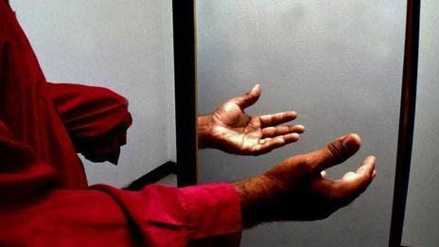
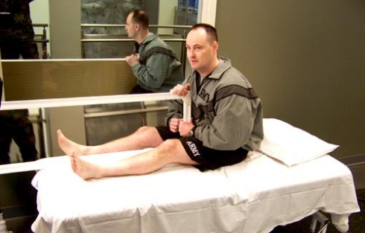
http://www.youtube.com/watch?v=YL_6OMPywnQ

Slide 34
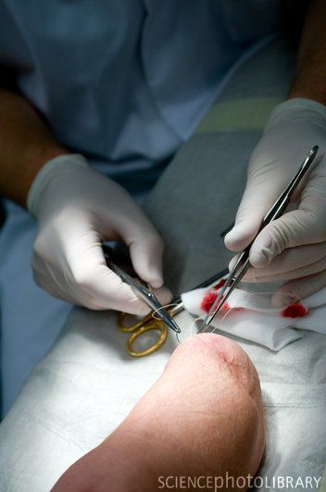
3. Wound Care – New Amputation
Goal – non-tender stump with healthy skin for prosthesis use
Elevate limb for first 24-48 hr or as instructed by surgeon
Gentle handling, sterile technique
Unwrap q4-6h for first 2 days postop, then OD
Assess color, temperature, pulses, signs infection & skin breakdown
Cleanse as ordered
Notes:
The overall goal of wound care is a non-tender residual limb with healthy skin for prosthesis use (Day et al., 2010). After surgery, a soft dressing or a rigid fiberglass or plaster dressing may be in place (Pullen, 2010). There are many options and choice depends on the amputation and the surgeon’s preference. The limb must be elevated for the first 24-48 hours (Pullen, 2010). Postop wound care requires gentle handling and sterile technique to prevent infection (Day et al., 2010). Assess integrity of dressing and drainage (Pullen, 2010). The dressing should be unwrapped q4-6h for the first 2 days postop as prescribed by surgeon, and then at least once daily after that (Pullen, 2010). Assess color, temperature, pulses, and signs of infection and skin breakdown before rewrapping (Pullen, 2010). Cleanse wound as ordered. Do not use lotion. Rewrap while limb is elevated to prevent edema and vascular stasis (Pullen, 2010). The bandage itself is changed q2-4 days, when soiled, or as per facility protocol (Pullen, 2010). If the elastic dressing or cast comes off, the nurse must notify the surgeon and immediately wrap the stump with an elastic compression bandage to prevent edema which could delay rehab (Day et al., 2010). Elastic bandaging also shapes the residual limb in a conical shape to facilitate prosthesis fitting (Day et al., 2010). Careful compression wrapping begins after day 7 postop. Prosthesis fitting occurs as soon as possible (Jacobs, Slozos, Ralble, Wendl, Frank, et al., 2011). Drainage catheter, if inserted, is removed on postop day 2 or when wound is no longer draining. Stitches are removed 14 days postop (Pullen, 2010).

Slide 35
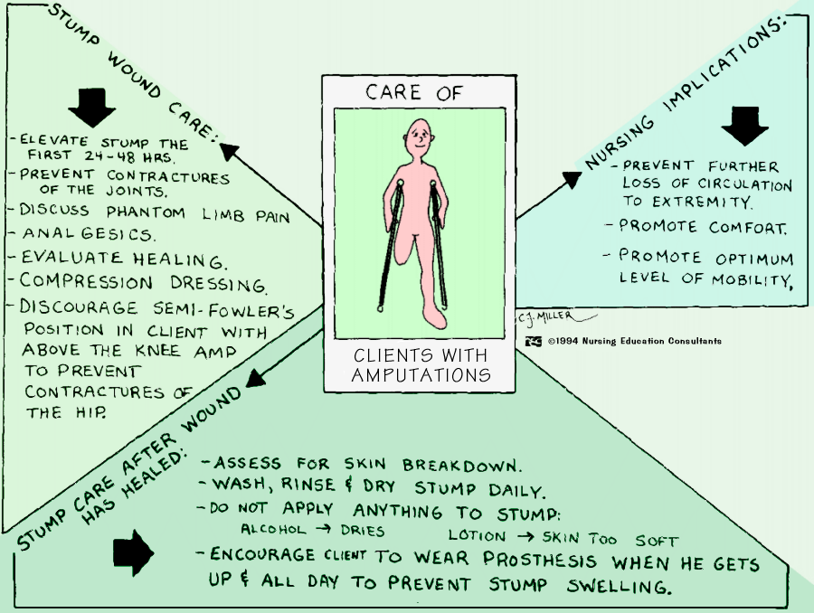

Slide 36
How to wrap a below the knee amputation
Notes:
Demonstration to be done for the class

Slide 37
How to wrap an above the knee amputation
Notes:
Demonstration to be done for the class

Slide 38
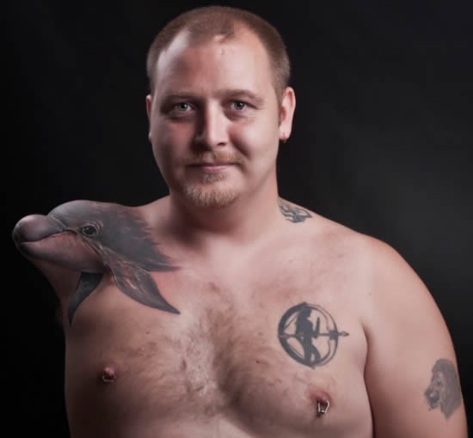
4. Accepting Body Image
Encourage patient to look at, feel, and care for residual limb
Identify strengths and resources to facilitate rehab
Help patient regain previous level of functioning
Notes:
Amputation has been associated with negative self-esteem and increased rates of depression and PTSD. Those with other comorbidities experience more adjustment difficulties and are at increased risk for depressive symptoms (Liu et al., 2010). The nurse can help the new amputee accept their altered body image. Encourage the patient to look at, feel, and care for the residual limb. Identify strengths and resources to facilitate rehabilitation (Day et al., 2010). Peer support through support groups or the War Amps organization alleviates emotional distress and decreased sense of isolation (Liu et al., 2010). Help patient regain previous level of functioning. This is a slow process that may take months (Day et al., 2010). Amputation does not always cause negative outcomes, however. Some amputees identify the experience of coping with opportunities to thrive or to change in beneficial ways. It sometimes triggers a change in how the amputee view themselves, their priorities, and their relationships with others (Liu et al., 2010).

Slide 39
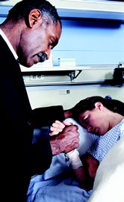
5. Resolving Grief
Normal part of the acceptance process
Acknowledge loss by listening and providing support
Supportive & accepting atmosphere
Encourage expression of feelings and family involvement in working through grief
Help to develop realistic goals
Notes:
As we mentioned earlier, expression of grief is a normal part of the process of accepting the loss of a limb. The nurse can acknowledge the loss by listening and providing support. Create a supportive and accepting atmosphere. Encourage the patient and their family to express their emotions and work through the grief process. Help the patient develop realistic goals and work towards independent functioning (Day et al., 2010).

Slide 40
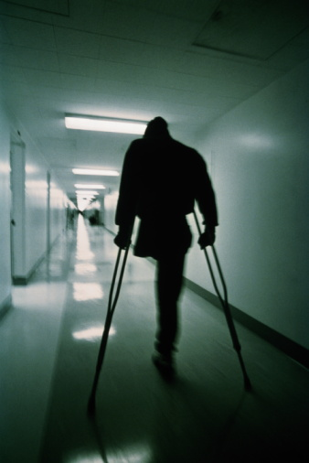
Complications
Hemorrhage
Infection
Skin breakdown
Joint contracture
Bony overgrowth
Phantom limb pain
Notes:
Complications after amputation surgery include hemorrhage, infection, skin breakdown, joint contracture, bony overgrowth, and phantom limb pain. PLP is a major consequence of surgery that influences the patient’s psychosocial wellbeing and rehabilitative progress, as we discussed earlier in the presentation (Day et al., 2010).

Slide 41
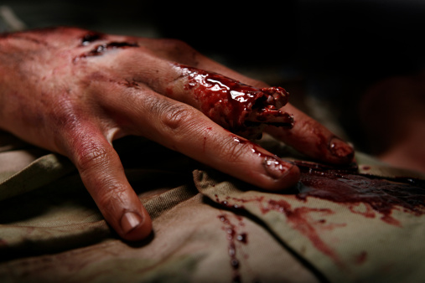
1. Hemorrhage
Caused by severed blood vessels or loosened sutures
Monitor VS
Monitor S&S bleeding
Monitor suction drainage if in place
Keep a tourniquet handy!
Notes:
Hemorrhage is a huge concern since all major blood vessels in the limb are severed during amputation. Immediate postop bleeding may develop slowly or may occur as a massive hemorrhage from a loosened suture. Bleeding due to loosened sutures is the most threatening postop complication. The nurse monitors VS, signs and symptoms of bleeding, and observes drainage. Keep a tourniquet in plain sight at the bedside to apply to residual limb if bleeding occurs. If there is excessive bleeding, notify physician (Day et al., 2010).

Slide 42
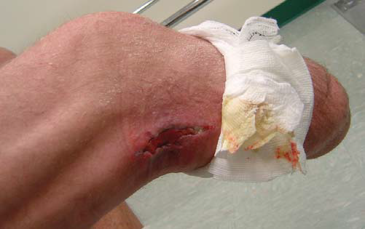
2. Infection
↑↑ with traumatic amputation due to contaminated wound
Monitor for:
Changes in color, odor, consistency of drainage
Increased discomfort
Signs systemic infection (i.e. ↑ T)
Report changes!
Notes:
Infection is a risk in all surgeries and this risk increases with contaminated wounds after a traumatic amputation. Postop antibiotics are given as prescribed. Monitor incision, dressing, drainage for signs & symptoms infection such as changes in color, odor, consistency of drainage, and increased discomfort. Monitor for symptoms of systemic infection such as increased temperature. Report changes to physician (Day et al., 2010).
Image – MRSA infection on residual limb (Highsmith & Highsmith, 2007)

Slide 43
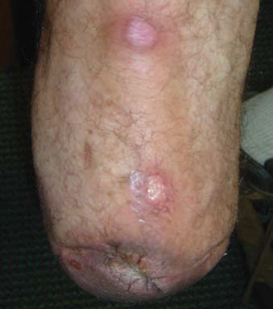
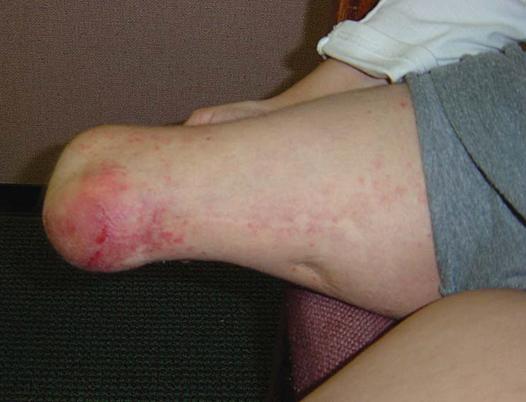
3. Skin Breakdown
Erythema
Pressure sores
Notes:
Skin breakdown may occur due to decreased mobility in the immediate postop period or due to skin irritation from the prosthesis. Skin pathology related to prosthesis use includes pressure sores, infection, and erythema (Highsmith & Highsmith, 2007). Both nurse and patient assess skin for signs of breakdown. Position change, careful skin hygiene, and stump care is important to prevent skin irritation, infection, and breakdown (Day et al., 2010).

Slide 44
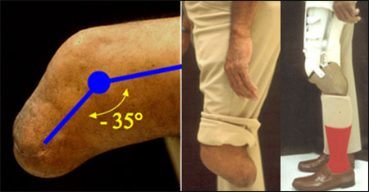
4. Joint Contracture
PREVENT!!
Proper positioning
Early ROM
Muscle strengthening
Notes:
Joint contracture is the abnormal shortening of a joint or muscle that leads to decreased mobility due to structural changes in the soft tissue (Day et al., 2010; Robinson et al., 2010). Contractures can cause delayed wound healing, complications with prosthetic fitting, and poor gait patterns (Robinson et al., 2010). This is a serious complication that can develop easily and rapidly if not properly managed. Prevention is carried out through positioning, ROM, and adequate pain control to prevent flexor withdrawal patterns (Robinson et al., 2010).
In lower extremity amputation, for example, avoid abduction, external rotation, and flexion. Raise the foot of the bed to elevate the limb. Do NOT place limb on pillow because flexion contracture of the hip may develop. Encourage frequent position change and lying supine to stretch flexor muscles and prevent flexion contracture of hip. Instruct client not to sit for long periods and to keep legs close together to prevent abduction deformity. In both upper and lower limb amputation, early ROM and muscle strengthening exercises can help prevent contracture (Day et al., 2010).
In this picture, the knee cannot extend to a fully straight position. As a result, the prosthesis must be made to accommodate the contracture. The modifications will limit step length, and increase energy expenditure (www.oandp.org).

Slide 45
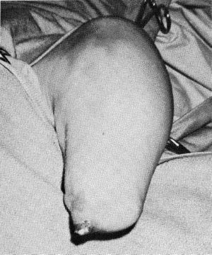
5. Bony Overgrowth
Signs:
Swelling
Warmth
Tenderness
More common in children
Tx: Revision surgery
Notes:
Bony overgrowth can occur in amputations that cut across bone, especially the long bones. When the bone is cut, the body works to heal itself. Normal bone growth combined with the cut bone’s growth may exceed the length of the overlying soft tissues. This may eventually lead to protrusion or even piercing of the skin overlying the growing bone. Signs of bony overgrowth include swelling, warmth, and tenderness at the end of the residual limb. This occurs most often in children with amputations since their bones are still growing. The standard treatment is revision surgery to cut and shorten the overgrown bone (www.waramps.ca).

Slide 46
Residual Limb
The skin on the residual limb sustains many stresses
Good skin care is essential
Risk for sore and abrasions
More bacteria can be found on the residual limb
Potential Skin conditions:
Rashes and Abrasions
Edema
Contact dermatitis
Cysts
Folliculitis
Fungal infections
Eczema
Adherent scars
Ulcers
Notes:
The skin on the residual limb sustains many stresses. This is why good skin care is essential. The skin on the stump is not designed for weight bearing or uneven pressures or friction against the prosthetic socket. These stresses have the potential to create issues such as sores and abrasions on the skin, therefore it must be looked after very carefully.
Proper stump hygiene is very important. Since the amputee has a smaller surface area of skin, the body’s natural cooling mechanism is less efficient. Prosthetic sockets trap sweat against the skin of the stump and prevent air circulation to dry the perspiration. Amputees also use more energy to get around than those without amputations. This increases the body’s temperature and therefore perspiration as well. Serious skin conditions can develop if not properly looked after. The warm, moist environment of the socket is a perfect breeding ground for bacteria that can cause skin problems. Skin conditions may require the amputee to stop wearing the artificial limbs until the condition has healed.
The longer the amputee wears the prosthetic, the more important this issue becomes.
Bacteria and other organisms are found on the skin. Some of these are harmless, while others can cause infection given the right circumstances. Skin normally expels bacteria through drying by evaporation, and also by releasing special fatty acids from glands on its surface. Unfortunately, this drying can't occur in the moist environment of the enclosed socket of an artificial limb. Normal skin has a negative charge which repels bacteria, but when an amputee's skin is bathed in salty perspiration for long periods, a positive charge can develop which can attract more bacteria. Hygiene becomes even more important in these circumstances where the number of potentially infection-causing germs has increased beyond the skin's normal capacity.
Some potential skin conditions that could occur on the residual limb include:
Rashes and Abrasions - these are the most common skin disorder which may occur intermittently or even frequently throughout the amputee's life time.
Edema - characterized by skin swelling, drying and roughening at the end of the stump, and a red-brown pigmentation, this can usually be prevented by gradual compression using an elastic bandage. Although this may seem like a minor affliction at first, it can develop into a serious complication - a doctor should always be consulted.
Contact Dermatitis - this is caused by an irritant, whether in the materials of the socket, or from an outside source, such as a cleaning agent, powder, lubricant or ointment used in amputee care. Once the cause is discovered and treated, the problem usually disappears.
Cysts - this usually occurs after a limb has been worn for months or even years. They commonly plague above-knee amputees, occurring on the inside of the leg along the upper edge of the artificial limb, but below-knee amputees can experience them as well. They start as small bumps, or nodules which vanish when the artificial limb is temporarily removed, but the constant rubbing of the artificial limb can make the problem worse as cysts become larger and more numerous. Cysts should always be treated by a doctor, as they can become infected and cause further damage.
Folliculitis - a bacterial infection of the hair follicle which produces small, itching, solid areas. If left untreated, these may later develop into boils in which deep-red, painful nodules rise to the surface of the skin. Anti-bacterial soaps may cut down on the bacteria which cause these conditions. Experienced amputees recommend not shaving the residual limb.
Fungal Infections - another product of the moist, warm conditions in the socket of an artificial limb, these require special creams or powders, which can eventually clear up the condition.
Eczema - this is found in dry, scaly skin which becomes moist for no discernable reason. A cause needs to be established or the condition will recur. Allergies, or secondary conditions following edema can contribute to the condition.
Adherent scars - when there has been repeated infection or ulceration damage to the skin, scar formation may be so intense that scar tissue may become attached to the underlying layers of skin. Surgical revision to free the scar is often necessary.
Ulcers - these sores come from bacterial infections, or from circulation problems. They may become chronic if not diagnosed and treated immediately.
(Quoted from www.waramps.ca)

Slide 47
Residual Limb
Must be shaped and conditioned into a conical form to permit proper fit of the prosthetic device
Bandaging supports soft tissue and reduces the formation of edema
Notes:
The residual limb must be shaped and conditioned into a conical form to permit an accurate fit with maximum comfort and function of the prosthetic device. Elastic bandages, elastic residual limb shrinker, or air splint are used to condition and shape the residual limb.
Bandaging supports soft tissue and reduces formation of edema while the residual limb is in dependent position. It is applied to strengthen the muscles that will be used with the prosthesis, while the other muscles that are no longer useful waste away.

Slide 48
Stump Care
Wash the stump daily.
Cleansing should be done at night rather than in the morning to prevent the damp skin from swelling and sticking to the inside of the socket
Wet the skin thoroughly with warm water
Use mild fragrance-free soap or antiseptic cleanser
Work up a foamy lather
Rinse well with clean water, ensuring all the soap is rinsed off. If a soap residue is left behind, this can cause irritation to the skin
Dry the skin thoroughly
Notes:
After the incision has healed the nurse teaches the patient and family how to care for the residual limb. Stump care involves washing the stump daily. This should be done in the evenings rather than in the morning to prevent the damp skin from swelling and sticking inside the socket. Wet the skin thoroughly with warm, not hot, water. Work up a lather with mild fragrance free soap or antiseptic cleanser. Rinse well with clean water, and ensure all soap residue is gone. If any residue remains, irritation to the skin can occur. Dry the skin thoroughly.

Slide 49
Stump Care
The sock
Helps keep perspiration away from the skin
Provides padding
Wash and change the sock daily or more when hot
Some use pH balanced antiperspirants
Notes:
A sock is often worn over the stump under the prosthesis.
Wearing a sock can help keep perspiration away from the skin. A light sock may have a cooling effect, and also provides additional padding for the stump.
The sock needs to be changed daily, or sometimes more if the weather is hot. It should be cleansed right away to prevent drying of perspiration.
Use mild soap and water and rinse thoroughly. A rubber ball of similar size to the residual limb can be placed inside the sock when it is not being worn to maintain its shape.
Some amputees use strong pH balanced antiperspirants to help reduce the amount of perspiration produced within the socket.

Slide 50
Stump Care
The socket of the prosthesis needs to be cleansed daily as well to eliminate built up residue from perspiration:
Wash with warm water and mild soap
Rinse thoroughly by wiping it with a clean cloth dampened with clean water
Dry thoroughly before putting on

Slide 51
Prostheses
Can be fit for almost any level of amputation
Can help restore locomotion and functional abilities
Require special training to use
Notes:
Although loss of a limb can cause disturbances in locomotion and functional abilities, prostheses can help restore some this functionality and add to the overall quality of life.
Prostheses can be fit for almost any level of amputation. They require special training with a multidisciplinary rehabilitation team.

Slide 52
Types of Prostheses
Mechanical
Electrical
Recreational arms and legs
Myoelectric Arm
Muscles can move the prosthetic arm
Training
Signal Training
Control Training
Functional Training
Notes:
Mechanical prostheses are durable and provide fine manual dexterity. They are able to be used in most physical environments such as water and dirt without damage. They are less comfortable and less cosmetically appealing to some because they do not look as much like a real limb as the electrical prosthesis. This can be very important to many people to help maintain a normal body image.
Electrical prostheses are more comfortable because they have a self-suspending socket rather than a harness. Electric prostheses also have a higher level of pinch force, which is up to five times greater than a cable-operated hand, without requiring more effort by the amputee.
Recreational arms and legs are available to allow the amputee to partake in higher energy recreational activities such as sports
Myoelectric arms are the most common electrical fittings.
How they work: Electrical impulses are sent through the muscle of the residual arm and are picked up by the prosthesis. These muscle impulses are translated into electrical signals that the prosthesis can use. There are usually two electrodes known as “control sites” on the residual limb that tell the hand to either open or close.
There are myoelectrics with proportional control, which means that the speed of opening or closing can be altered depending on the muscle contraction. It also allows for the ability to hold things with varying force so they can hold delicate objects gently, and heavier objects more firmly.
There is special training involved in learning how to use the myoelectric arm appropriately.
There are three phases of training:
Signal Training – which teaches the amputee how to control the muscles used to control the prosthetic arm. Electrodes are placed over the selected muscles and connected to a trainer which provides feedback as the muscles are contracted.
Control Training – Where the amputee learns to control the muscles to perform a specific function.
Functional Training - This is the most extensive phase that can take from two weeks to two months. It is very important that the prosthesis fits perfectly during functional training. In this phase the amputee must learn to become accustomed to wearing the artificial limb and see it as part of their body, and become proficient with the control of the myelectrics.

Slide 53
Recreational Prosthetic Leg

Slide 54
Prosthetic for Hip Disarticulation

Slide 55
Myoelectric Arm

Slide 56
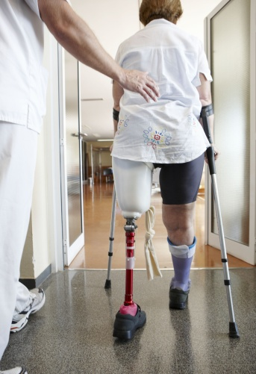
Rehabilitation
Goal – Highest possible level of functioning and participation in activities
Involves multidisciplinary team
What can the nurse do?
Collaborate
Begin ROM and muscle strengthening exercises ASAP
Ensure safety, prevent risk for falls/injury
Encourage self-care and independence
Create a supportive environment
Notes:
Rehabilitation begins soon after surgery. The goal of rehab is to help the client achieve the highest possible level of functioning and participation in life activities. Age of the patient and level of amputation are the two most significant predictors of post-rehab functional outcome (Kelly & Dowling, 2008). The patient collaborates with a multidisciplinary team consisting of a nurse, doctor, social worker, psychologist, prosthetist, physiotherapist, occupational therapist, and vocational rehab worker. This is because rehab is multidimensional – it incorporates psychosocial support with exercise and gains in physical functioning and usual activities (Day et al., 2010).
In the postop period, help the patient with ROM and other exercises to strengthen muscles (Pullen, 2010). A loss of an upper extremity may lead postural abnormalities because of the loss of weight of the amputated limb. Muscle strengthening exercises are crucial for this patient to prevent these abnormalities. Loss of a leg alters the center of gravity so the patient may need to practice position change and safe transfers. Encourage active participation in self-care. This can be facilitated by not rushing the patient, creating a relaxed and positive environment, and providing consistently supportive supervision (Day et al., 2010).
Fitting for prosthesis will occur as soon as possible. Encourage the patient to push the residual limb into a soft pillow, then a firm pillow, and then a harder surface to decrease incidence of phantom limb pain and prepare for prosthesis fitting (Pullen, 2010).
Once the patient’s medical status has stabilized and major health goals achieved, rehab will continue in a rehab facility or at home. When returning home, it is important to assess the home environment and arrange for necessary modifications or support to ensure continuing care, safety, and mobility. Follow-up visits evaluate physical and psychosocial adjustment (Day et al., 2010).

Slide 57
Nursing Diagnoses
Acute pain r/t surgical amputation
Risk for infection r/t a site for organism invasion 2º to surgical amputation
Impaired skin integrity r/t surgical amputation
Risk for disturbed sensory perception: phantom limb pain r/t surgical amputation
Disturbed body image r/t amputation of a body part
Disturbed self-concept r/t loss of a body part
Risk for anticipatory grieving r/t loss of a body part
Risk for dysfunctional grieving r/t loss of a body part
Impaired physical mobility r/t loss of extremity
Self-care deficit: feeding, bathing, hygiene, dressing, grooming, or toileting r/t loss of extremity
Risk for falls r/t loss of lower extremity
Fear r/t surgery, coping with the loss of limb after surgery
Ineffective coping r/t failure to accept loss of a body part

Slide 58
Case Study
Peter is a 37 year old male transported via EHS to ER following a MVA involving a drunk driver. Peter’s leg was mangled with complete above knee amputation. Once stabilized to the extent possible, he was taken to the OR and is returning to your unit after surgery. Peter’s blood work reveals decreased Hgb, decreased PLTs, and increased WBCs. He is resting in his bed as sedation from surgery wears off
1) What are your top nursing priorities in Peter’s care?
Peter reports “excruciating pain” at an 8 on a pain scale from 1- 10. On further assessment, you find P 100bpm, R 22/min, BP 90/68 mmHg. Moving his sheets, you realize Peter’s dressing is saturated in frank, red blood that is seeping into the bed linens. What do you do?
3) Peter’s physiologic status eventually stabilizes and he progresses in rehab with his new prosthesis. On a follow-up visit, he reports a strange and painful sensation in his amputated limb. “It’s as though my whole leg is still there only my toes are crossed over each other, and I can’t fix it. It often feels like pins and needles,” Peter reports. What complication is Peter describing? What are some interventions to relieve or decrease this sensation?

Slide 59
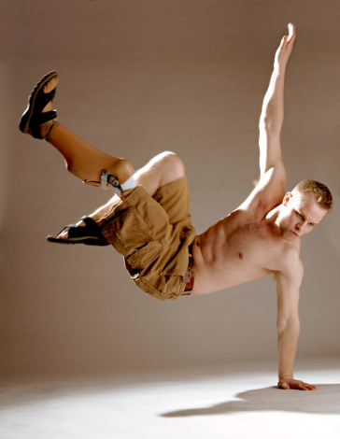
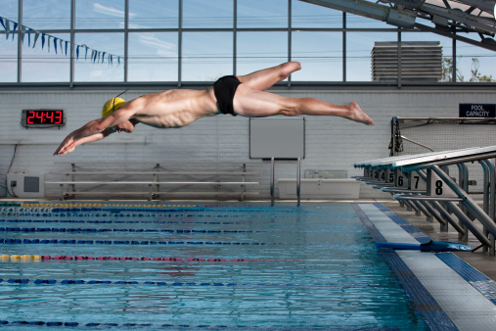
Questions?

Slide 60
References
Amputation; Stump. (2009). Mosby’s dictionary of medicine, nursing, and health professions (8th ed.). St. Louis, MO: Mosby Elsevier.
Andrews, K. L. (2011). The at-risk foot: What to do before and after amputation. Journal of Vascular Nursing, 29, 120-123. doi:10.1016/j.jvn.2011.07.004
Brennan, E., Hain, A., Keenan, A., O’Brien, J., & Wilding, L. (2007). Case study: Traumatic amputation. Outlook, 30(2), 15-19.
Carpenito-Moyet, L. J. (2010). Nursing diagnosis: Application to clinical practice (13th ed.). Philadelphia, PA: Lippincott Williams & Wilkins.
Chapman, S. (2010). Pain management in patients following limb amputation. Nursing Standard, 25(19), 35-40.
Day, R. A., Paul, P., Williams, B., Smeltzer, C., & Bare, B. (2010). Textbook of Canadian medical-surgical nursing (2nd Canadian ed.). Philadelphia, PA: Lippincott Williams & Wilkins.
Getty Images. (2012). MedicImage. Retrieved from http://www.gettyimages.ca
Highsmith, J. T., & Highsmith, M. J. (2007). Common skin pathology in LE prosthesis users. Journal of the American Academy of
Physician Assistants, 20(11), 33-x1.
Jacobs, C., Siozos, P., Raible, C., Wendl, K., Frank, C., Grutzner, P. A., & Wolfl, C. (2011). Amputation of a lower extremity after
severe trauma. Operative Orthopadle und Traumatologie (4), 306-317. doi:10.1007/s00064-011-0043-9
Kelly, M., &, Dowling, M. (2008). Patient rehabilitation following lower limb amputation. Nursing Standard, 22(49), 35-40.
Kratz, A., Raichle, K. A., Williams, R.M., Turner, A. P., Smith, D. G., & Ehde, D. (2010). To lump or to split? Comparing individuals with traumatic and nontraumatic limb loss in the first year after amputation. Rehabilitation Psychology, 55(2), 126-138. doi:10.1037/a0019492
Liu, F., Williams, R. M., Liu, H-E., & Chien, N-H. (2010). The lived experience of persons with lower extremity amputation.
Journal of Clinical Nursing, 19, 2152-2161. doi:10.1111/j.1365-2702.2010.032.56.x
Melzack, R., & Wall, P. D. (1996). The challenge of pain: A modern medical classic. Toronto, ON: Penguin.
Pullen, R. (2010). Caring for a patient after amputation. Nursing 2010, 15.
Raichle, K. A., Hanley, M. A., Molton, I., Kadel, N. J., Campbell, K., Phelps, E., Ehde, D., Smith, D. R. (2008). Prosthesis use in persons with lower and upper amputation. Journal of Rehabilitation Research & Development, 45(7), 961-972. doi:10.1682/JRRD.2007.09.0151
Richardson, C. (2008). Nursing aspects of phantom limb pain following amputation. British Journal of Nursing, 17(7), 422-426.
Robinson, V., Sansam, K., Hirst, L., & Neumann, V. (2010). Major lower limb amputation: What, why, and how to achieve the
best results. Orthopedics and Trauma, 24(4), 276-285.
The War Amps of Canada. (2012). Retrieved from http://www.waramps.ca

