Slide 1
Customer Expectations of Service
Chapter 4

Slide 2
Customer Expectations of Service
Influenced by the type and meaning of service
Meaning or the significance of the service
Expectations are influenced by a reference point that the customer holds – examples?

Slide 3
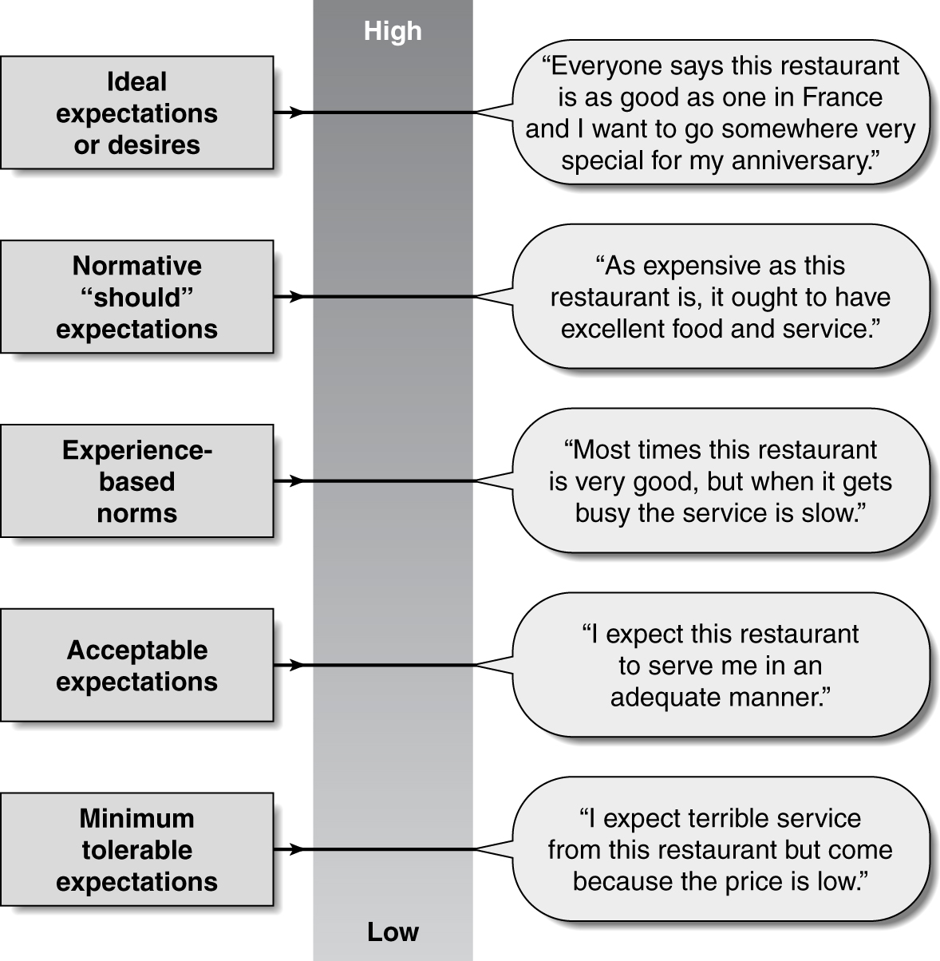
Possible Levels of Customer Expectations

Slide 4
Service Levels and Zones of Tolerance
Desired service is the level of service that a customer hopes to receive.
Adequate service is a threshold of acceptable service.
Zone of tolerance is the variation in service that customers recognize and are willing to accept.
Desired Service
Zone of
Tolerance
Adequate Service

Slide 5
Zones of Tolerance for Different Service Dimensions
Desired Service
Level
of
Expectation
Zone
of
Tolerance
Desired Service
Zone
of
Tolerance
Adequate Service
Adequate Service
Reliability
Tangibles
Source: L. L. Berry, A. Parasuraman, and V. A. Zeithaml, “Ten Lessons for Improving Service Quality,” Marketing Science Institute, Report No. 93-104 (May 1993).

Slide 6
Factors That Influence Desired Service
Figure 4.6
Lasting Service
Intensifiers
Desired Service
Personal Needs
Zone
of
Tolerance
Adequate Service

Slide 7
Factors that Influence Desired Service Expectations
Lasting Service Intensifiers
Individual, stable factors that lead the customer to a higher understanding of the service. This can be driven by another person or a group of people.
Personal Needs
Lasting service intensifiers are also driven by an individual’s personal service philosophy.

Slide 8
Factors That Influence Adequate Service
Figure 4.7
Temporary Service
Intensifiers
Desired Service
Perceived Service
Alternatives
Zone
of
Tolerance
Self-Perceived
Service Role
Predicted
Service
Adequate Service
Situational
Factors

Slide 9
Factors that Influence Adequate Service
Temporary Service Intensifiers
Short-term individual factors that make a customer more aware of the need for service
Perceived Service Alternatives
Other service providers that may perform the same or similar services
Self-perceived service role
Customer involvement in the delivery of the service
Situational Factors
Usually factors beyond the control of the service provider

Slide 10
Factors that Influence Adequate Service
Predicted Service
Explicit service promises
Implicit service promises
Word of mouth communication
Past experiences

