Slide 1
Advertising Strategies
Executional Frameworks
Chapter 7

Slide 2
Message Strategies
Message strategies are used to deliver a message theme (Chapter 5)

Slide 3
Message Strategies
Cognitive
Affective
Conative
Brand
Generic
Preemptive
Unique Selling Proposition
Hyperbole
Comparative

Slide 4
Generic Cognitive Message Strategy
An ad for Koestler Granite & Marble using a generic cognitive message strategy.
Click picture for video.

Slide 5
Preemptive Cognitive Message Strategy
An ad for the Waterfront Grill created by Sartor Associates using a pre-emptive cognitive message strategy.
Click picture for video.

Slide 6
Message Strategies
Cognitive
Affective
Conative
Brand
Resonance
Emotional

Slide 7
Message Strategies
Cognitive
Affective
Conative
Brand
Action-inducing
Promotional support

Slide 8
An advertisement by Fisher Boy encouraging consumers to enter the contest.

Slide 9
Message Strategies
Cognitive
Affective
Conative
Brand
Brand user
Brand image
Brand usage

Slide 10
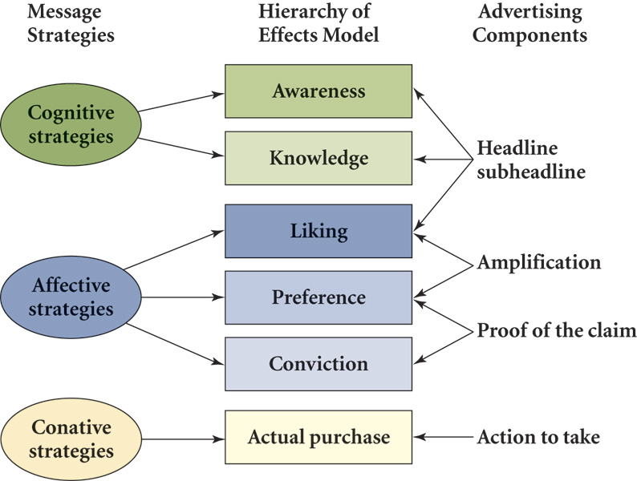
F I G U R E 7 . 2
The Hierarchy of Effects Model, Message Strategies, and Advertising Components

Slide 11
Executional Frameworks
An executional framework is the manner in which an ad appeal (Chapter 6) is presented.

Slide 12
Figure 7-3 Executional Frameworks
Animation
Slice-of-life
Dramatization
http://www.youtube.com/watch?v=1DU5LKoC1A8&NR=1
Testimonial
Authoritative
Demonstration
Fantasy
Informative

Slide 13
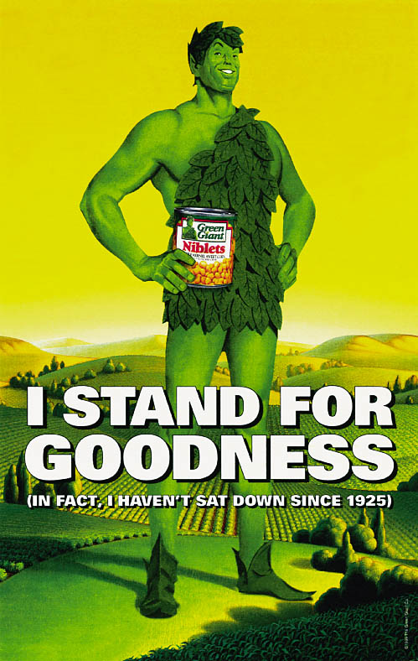
Animation
Originally only used by firms with a small advertising budget
Use has increased due to computer graphics technology.
Some Web sites to explore
Http://www.greengiant.com
Http://www.doughboy.com
Http://www.animationlibrary.com

Slide 14
Components of a Slice-of-Life Ad
F I G U R E 7. 4
Solution
Interaction
Problem
Encounter

Slide 15
Sources of Spokespersons
Celebrities
CEOs
Experts
Typical persons
Source

Slide 16
Characteristics of Effective Spokespeople
Attractiveness
Physical
Personality
Likability
Trustworthiness
Expertise
Credibility

Slide 17
Matching Source Types and Characteristics
Celebrities
Tend to score high in credibility
Negative publicity
Endorsement of too many products
CEO
Trustworthy, expertise, and some credibility
Must exercise care in selection
Expert
Seek experts who are attractive, likable, trustworthy
Valid credentials important
Typical person
Multiple typical persons increase credibility
Real-person
Actor

Slide 18
Principles of Effective Advertising
Visual consistency
Campaign duration
Repeated taglines
Consistent positioning
Simplicity
Identifiable selling point
Effective flow of message

Slide 19
Beating Ad Clutter
Use repetition
Variability Theory
Use multiple mediums.
Create ads that gain attention – any dangers of this?
Create ads that relate to the target audience

Slide 20
Which taglines can you identify?
It’s everywhere you want to be.
Just do it.
You’re in good hands.
The brushing that works between brushings.
What can brown do for you?
A different kind of company. A different kind of car.
When you care enough to send the very best.
It takes a licking and keeps on ticking.
What can brown do for you?
Can you hear me now?
I’m loving it!

