Slide 1
Prelude
Some Microsoft Goodies
Bernard Liengme
bliengme@stfx.ca

Slide 2
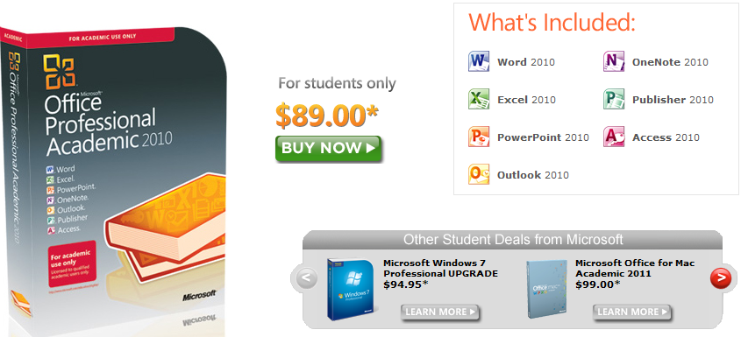
Microsoft Store Student Pricing
http://www.microsoft.com/student/office/en-ca/default.aspx

Slide 3
Microsoft Word Math Add-in
http://www.microsoft.com/download/en/details.aspx?id=17786
calculate numerical results
plot graphs in 2D and 3D
solve equations or inequalities
simplify algebraic expressions
All within a Word or One Note document

Slide 4
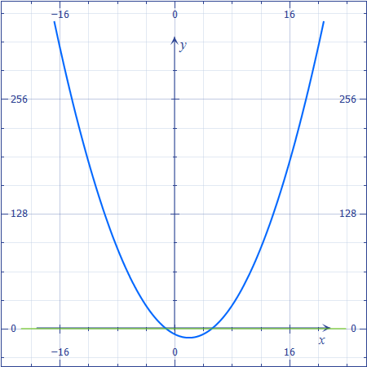
Video of Word Math Add-in
Click me!

Slide 5
Microsoft Mathematics 4 A software graphics calculator
Mathematics 4 (Msetup_X64.exe or Msetup_X86.exe)
http://www.microsoft.com/download/en/details.aspx?id=15702
Teaching Guide: http://download.microsoft.com/download/D/F/0/DF087781-EDEF-45E1-9FAA-18FE7CD1E7E3/microsoft%20mathematics_teacherguide.pdf
Movie time

Slide 6
And into the cloud….
Windows Live
This is the email client in Windows 7
http://explore.live.com/
But there is more….
SkyDrive is a place where you can store up to 25 GB of files; get at them any time, anywhere. Save place to store. Handy when you are away from your desk (your campus) and need a file.
http://explore.live.com/skydrive
Widows Live Mesh
I keep a number of folder synched on three computers – main desktop, laptop and back-up desktop. Not sure if you can synch your university H drive.
http://explore.live.com/windows-live-essentials-other-programs?T1=t4&os=other

