Slide 1
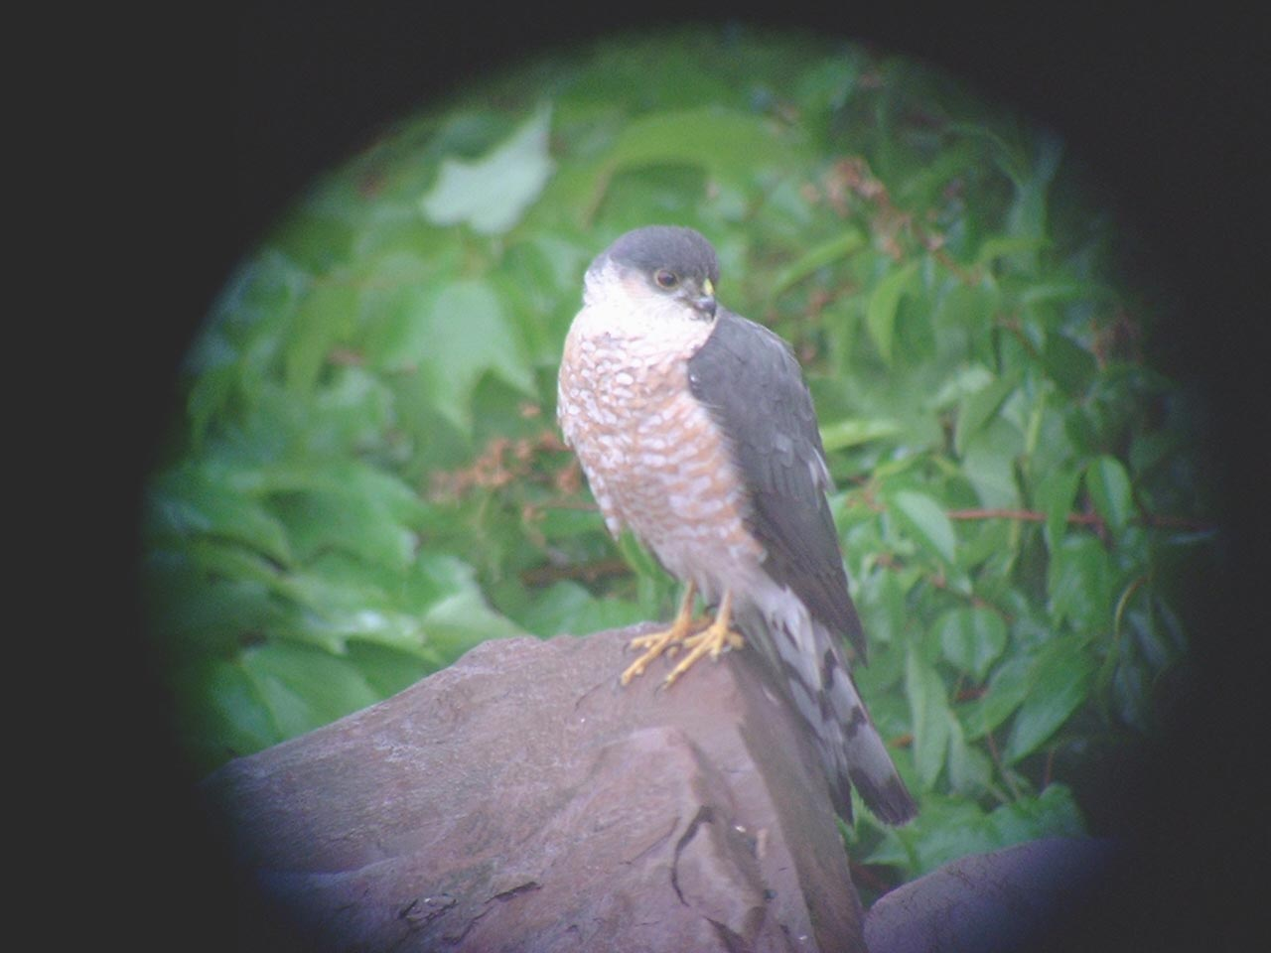
Measuring Claw Curvature

Slide 2
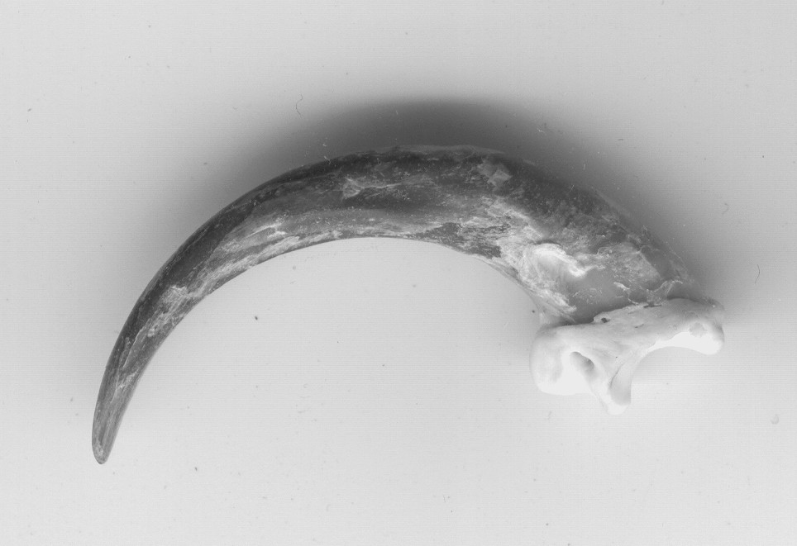
Measuring Claw Curvature
Step 1. Draw chord AB from the tip of the claw (A) to the anterior
margin of the tubercle at the base of the phalanx (B).
Step 2. Draw chord CD half way between A and B, and
perpendicular to chord AB.
C
B
A
D

Slide 3
Step 3. Draw in chords AX and XB.
Step 4. Perpendiculars are drawn to bisect AX (EE’) and XB (E’E”). Note that they must cross each other (at E).
E’’
C
X
E
B
D
A
E’

Slide 4
Step 5. Draw the final two chords AE’ and E’B.
Step 6. With a protractor, measure the angle between AE’ and E’B.
E’’
C
X
E
B
D
A
E’

Slide 5
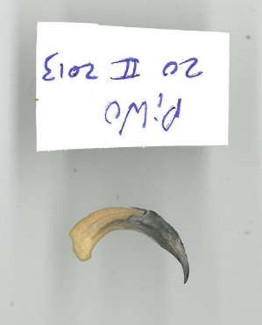
Try the technique on a few of the following claws. You can add lines here in this file, but I don’t think you can get PowerPoint to give you an angle. Hold your protractor up to the screen to get the angle.
Pileated Woodpecker

Slide 6
Belted Kingfisher
Atlantic Puffin

Slide 7
Ignore the Plasticine –
it’s just supporting the claw.
Common Eider

Slide 8
Greater Black-backed Gull
Ignore the Plasticine –
it’s just supporting the claw.
Great Blue Heron

Slide 9
