Slide 1
Welcome to Honours…
Honours Booklet
Second Reader
Expectations (6 credits); grade ranges
Advanced Major
Importance Communication with Supervisor(s)

Slide 2
KEY FALL DEADLINES:
Propose: October/Nov 2024
-Submit electronic copy (cweaving@ &smackenz) of proposal: NOVEMBER 15 before 5PM
-Submit REB before December break

Slide 3
FALL Seminar Schedule
September 11- Intro/Proposal (today)
September 18- HKIN Library Liaison Pres.
September 25-REB info
October 2- Pursuing a Masters
**Honours Proposals Presentations
--we will need to finalize a schedule

Slide 4
Proposal Presentation Tips
September 2024

Slide 5
Purpose
I argue in this paper that sexism was not only visible but appeared to be embraced at the most recent Winter Olympic Games in Vancouver. I refer to three examples and incidences from the Games that will help to illustrate the prominence of inequality that occurred during the Vancouver Games. More specifically, I argue that the root of the problem has to do with treating women athletes primarily as objects rather than subjects and full-fledged athletes. Sport should celebrate the human as body-subject; however, its historical exclusion of women reinforces the female as body-object. By perpetuating this problematic dualistic approach, women athletes’ subjectivity and autonomy is significantly decreased or in some cases is non-existent. An in-depth examination of the complexity of treating women Olympians as objects should help to divulge and breakdown some of the underpinnings surrounding sexism.
I. Introduction
This essay contains two sections that when combined demonstrate that the Olympic Games perpetuates sexism. More specifically, I will show that objectification is detrimental to women Olympians in not only a sexualized form, but also in consistently treating women athletes solely as bodies, or objects. It may appear as though I set out to accomplish too much in making this claim; however, an analysis of examples stemming solely from the recent Vancouver Olympic Games will show how the continued

Slide 6
Suggestions:
Avoid Serif Fonts… Use Sans Serif Fonts
@ least size: 32
Colour schemes (a la stop sign)
Bullet points come up separately
Include references (pg #--direct quotes)
Adhere to time guidelines (10 mins)
Can include pics., graphs, illustrations, etc.
PRACTICE! PRACTICE! PRACTICE!

Slide 7
Proposal presentations must include the following:
Title Slide: title, name, date
**outline/overview of presentation***
Introduction
Literature Review (cannot include it all!!)
Purpose/thesis statement/hypothesis **
Methodology
Procedures/study design
Acknowledge advisor/second reader

Slide 8
Qualitative-theoretical Presentations
Delivery- reading style
N/A: hypothesis/procedures/limits/delims
Describe methodology (philo, historical, sociological…etc.). See 397 HK

Slide 9
Quantitative Presentations
Minimal Lit Review
Detailed Methods
  More slides with less info/slide good
  Pictures/Diagrams good
Be very clear on your statistics
  Refer to HK 396 and Research Methods text
Provide example results
  This is what my results would look like

Slide 10
Excel Default is not good

Slide 11
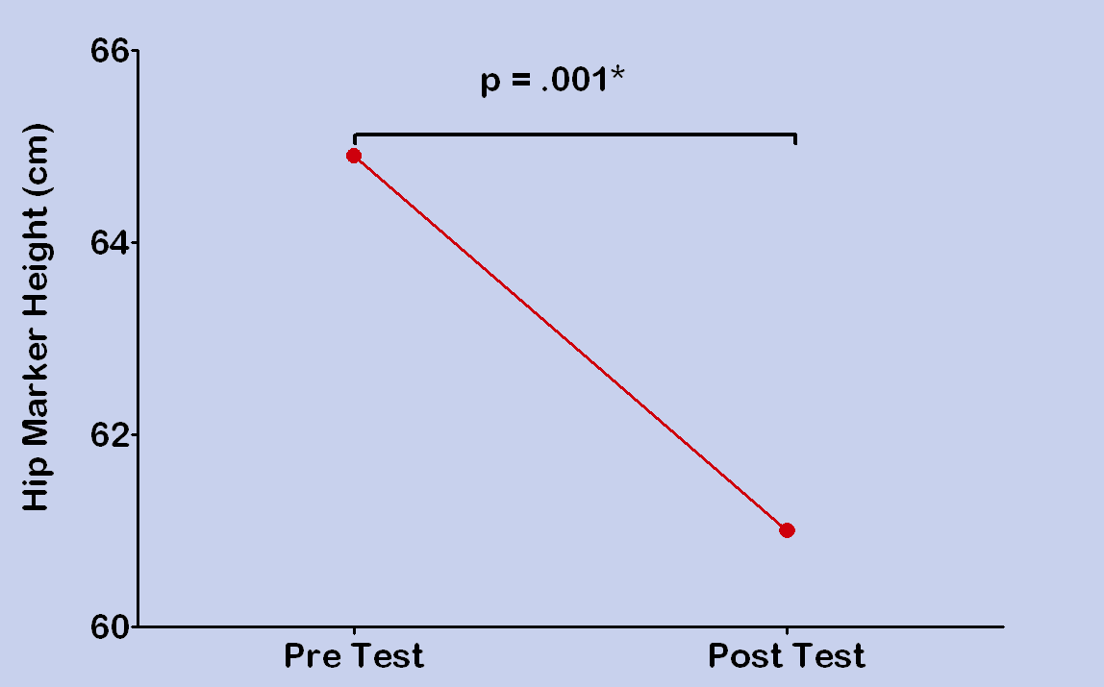
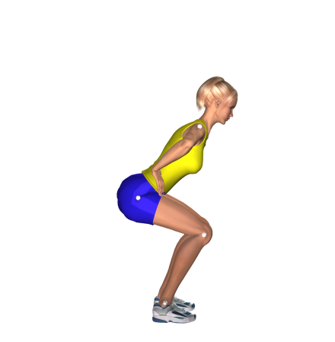
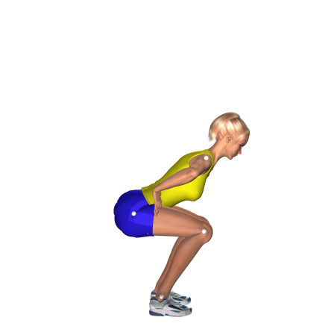
Subjects had a lower preferred squat depth after training

Slide 12
Tables with lots of info are BAD

Slide 13
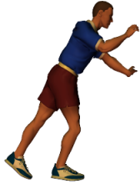
Data Collection
Calibration Volume
One pole with 4 spherical markers
    Moved to 10 precise calibration points
    Moved to 3 verification points
_{Y}
z
x
13
Camera 1
Camera 2
Notes:
13

Slide 14
Jam Results into 1 slide = Bad
 | Preferred | Deep | T-stat | P-value
Push-Off Time (s) | 0.4 | 0.6 | 4.07 | .002
Peak Force (N/kg) | 98 | 88 | 4.57 | .001
Average Force (N/kg) | 55 | 45 | 4.43 | .001

Slide 15
Push-Off Time

Slide 16
Peak Force

Slide 17
Average Force

Slide 18
???? Question Period ??????
Avoid reliance on advisor
Think before you speak
Make sure you understand the question before answer…ask for clarification
“thank you, I will consider that”
Do not take criticism personally

Slide 19
Feedback from Proposal Presentations
You will receive anonymous collection of comments from faculty.
Use feedback to improve your proposal and overall project

Slide 20
Written Proposal
DUE NOVEMBER 15 (by 5PM)
Via email: cweaving@stfx.ca & smackenz@stfx.ca
PDF
Advisor and Second Reader have provided feedback—feedback has been incorporated.
INCLUDE: title page, Intro, Lit Review, Purpose/Thesis Statement, Methodology, Limits/Delims (if applicable). Bibliography/Reference Page

