Slide 1
An unequal contest: A comparison of Geertz’ and Roseberry’s analyses of the Balinese Cockfight Susan Vincent
Notes:
My hypothetical paper is based on a comparison of two theories via their distinct discussions of the Balinese cockfight. The title indicates this, and suggests that I will clearly come out on one side, although it does not say which.

Slide 2
Context: Geertz’ famous essay on the Balinese cockfight and Roseberry’s critique of it
Purpose: to compare the two and decide which provides a better analysis
Notes:
I need to provide the context of the discussion, and must assume a reader who does not know the works. Here I also explicitly state the purpose of the paper.

Slide 3
Theoretical framework: feminist Marxist framework in which the structure of the economy and its associated inequalities (including ethnic, national, gendered, etc.) are central; also, a focus on conflict that is related to these inequalities; finally, a recognition of the dynamic processes associated with social life, inequality, conflict.
Notes:
Essays must provide the theoretical framework the author will use to analyse information. Here I give the overall framework and some specific concepts, although I haven’t given full definitions.

Slide 4
Argument: I argue that Roseberry’s critique of Geertz is valid because Roseberry calls attention to economic factors, inequality, conflict and dynamic social process; in contrast, Geertz’ interpretation is entertaining and descriptive, but partial.
Notes:
Obviously, since an argument is the defense of an argument, I must indicate the argument.

Slide 5
Note: Geertz has been to Bali and Roseberry has not.
Notes:
This is an important observation that listeners might need to know as they consider whether to believe my argument or not.

Slide 6
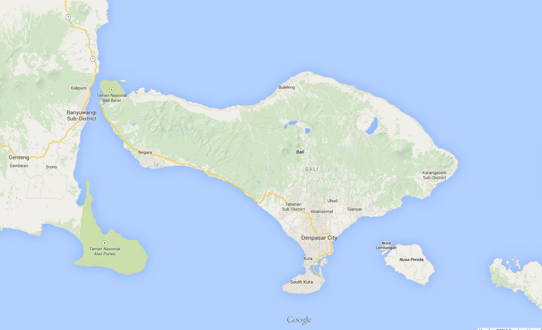
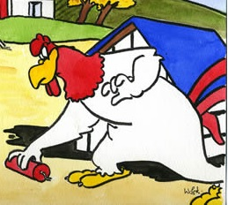
Geertz: symbolic importance of fighting cocks in Bali
www.google.ca/maps/place/Bali
http://www.ackreds-watercolour-art.co.uk/images/Pics_Big/Cartoons14.jpg
Notes:
This outlines Geertz’ position: he emphasises the symbolic importance of cocks in Bali, part of which relates to the shape of the island being considered like a cock.

Slide 7
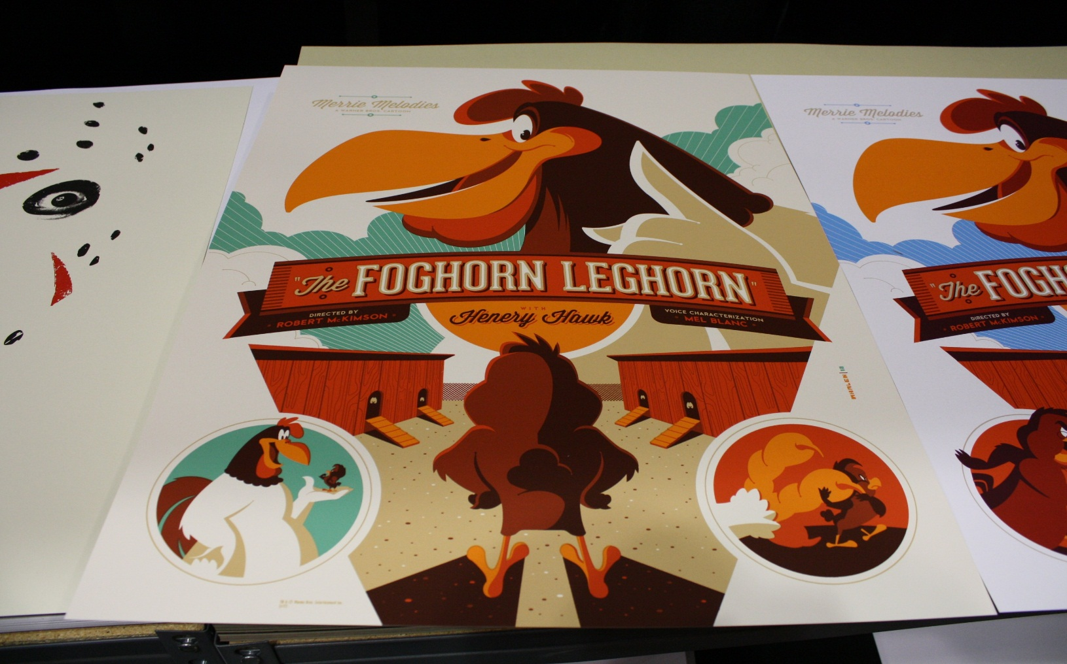
Geertz’ analysis: ritualized social action (and all culture) is “written” by those who experience it and “read” by others as a text, to give ideas of how to live and understand life.
https://http://collider.com/wp-content/uploads/Tom-Whalen-Foghorn-Leghorn-poster-1.jpg
https://encrypted-tb40x9FlDR_-zs
Notes:
Geertz analyses the cockfight as a text, that is, a representation of life’s meaning as written by Balinese and for “reading” by Balinese.

Slide 8

Specifically, the cockfight teaches how to risk all to win or lose, and about the experience of status gain and loss.

Slide 9
Geertz’ analysis
Lively
Entertaining
Has interesting and suggestive information, including in the footnotes
Notes:
This is my critical appreciation of Geertz’ analysis.

Slide 10
In contrast, Roseberry points to elements hinted at by Geertz, but insufficiently addressed in the analysis.
Notes:
Then I go on to present Roseberry’s critique of Geertz.

Slide 11

Roseberry notes the relationship of cockfights to the economy, specifically to markets and taxation
Notes:
Cockfights have long taken place in association with markets, and Roseberry notes that Geertz tells us that they were linked to monetization. Geertz also provides evidence that lords taxed both markets and cockfights, perhaps for public expenditure or for their own coffers.

Slide 12
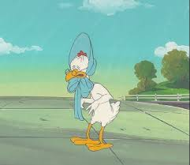

Roseberry also focuses on inequalities in Bali
http://www.badweatherbikers.com/buell/messages/496363/318266.jpg
https://encrypted-tbn1.gstatic.com/images?q=tbn:ANd9GcQGmV9hKSXSS_SKBBpxL7IMmBfXdBNXMSExBOCk2gKXj4yTtVi6
Notes:
While Geertz glosses over inequalities, Roseberry picks them out, including the unusual exclusion of women from cockfighting when there is little gender-based differentiation elsewhere in Balinese society, and the hierarchies of elites over others and of the Javanese/Dutch over the Balinese.

Slide 13
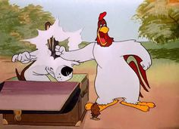
As well as conflict
https://s-media-cache-ak0.pinimg.com/236x/dc/b7/3d/dcb73d589ef73e9abd0eac7f6b2d240b.jpg
Notes:
Roseberry also suggests there is tension between groups, although he does not focus on conflict. He does, however, link status, which Geertz says is central to the cockfight, to both historical and contemporary struggles for position.

Slide 14
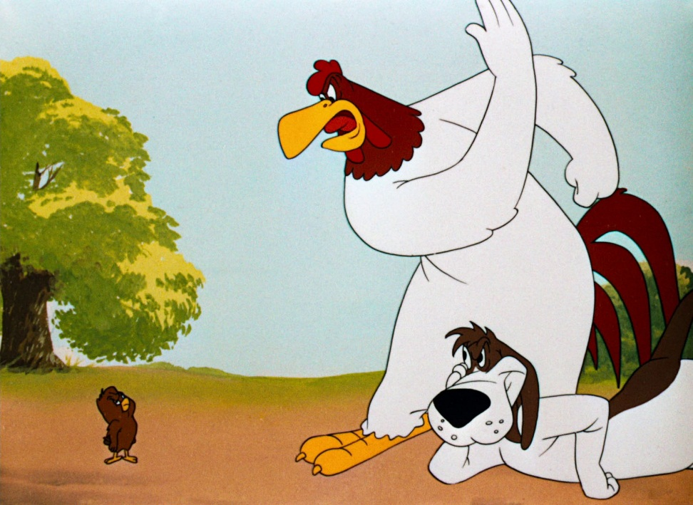
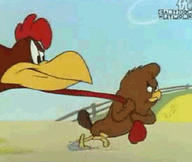
And dynamic social process
http://media1.giphy.com/media/mGd556BOp4Kk0/200_s.gif
http://www.blessthemess.pl/wp-content/uploads/2014/04/The-Foghorn-Leghorn-12.jpg
Notes:
Roseberry, of course, emphasizes history, arguing that one cannot understand the current cockfight without understanding the hierarchical system of pre-colonial Bali, the colonial period and the current era of Indonesian domination.

Slide 15
Roseberry’s analysis
Roseberry’s focus, thus parallels my own theoretical priorities: economic structure, inequality, conflict and material social process
Notes:
I have drawn out here elements that Roseberry emphasizes that match my priorities as stated in my theoretical framework.

Slide 16
BUT …
Notes:
However, Roseberry does not address all of the things I see as important, nor does he address issues in as detailed a critique as I would like.

Slide 17
What I would have liked to see more of:
Role of gender – why don’t the women bet? What status do they get from working in the market? How do women get status?
How do things get produced in this society?
Notes:
Geertz continually refers to “Balinese” when he is, in fact, referring to males and probably village elite males. The reference to “only women, children, adolescents …the socially despised …” is offensive to me (Geertz 2005: 73). Neither explains the basis of the economy.

Slide 18
Also,
What about the massacre that Geertz mentions in note 43? Might that not be more important to understand than how the cockfight provides a (possible) cultural script to (some, male, elite) Balinese?
Notes:
While Geertz mentions a massacre in 1965 and suggests, while demurring that he is suggesting, that it has something to do with the hidden violence in Balinese character that emerges in cockfights, neither focuses on this. I think it is an important event to study.

Slide 19
Conclusion
Geertz: interesting
Roseberry: important
But also need to consider further aspects of article
Notes:
Just as every essay ends with a conclusion that sums up the argument and presents implications/significance/further study, so does my pechakucha.

Slide 20
References
Geertz, Clifford (2005)“Deep Play: Notes on the Balinese Cockfight.” Daedalus. 134(4): 56-86.
Roseberry, William (1982) “Balinese Cockfights and the Seduction of Anthropology.” Social Research. 49(4): 1013-1028.

