Slide 1
What is topology?
The word topology comes from the Greek topos, "place," and logos, "study”
Topology was known as geometria situs (Latin geometry of place) or analysis situs (Latin analysis of place).
The thing that distinguishes different kinds of geometries is in terms of the kinds of transformations that are allowed before you consider something changed

Slide 2
Suppose we could study objects that could be stretched, bent, or otherwise distorted without tearing or scattering. This is topology (also known as “rubber sheet geometry”).
Topology is the modern form of geometry
Topology is the most basic form of geometry there is
Used in nearly all branches of mathematics

Slide 3
Topological Equivalence
Topology investigates basic structure like number of holes or how many components.
Two spaces are topologically equivalent if one can be formed into the other without tearing edges, puncturing holes, or attaching non attached edges.
So a circle, a triangle and a square are all equivalent

Slide 4
Not Topologically Equivalent
A circle and a figure 8 are NOT topologically equivalent- you can continuously transform the circle to the figure 8, but not the figure 8 to a circle
O 8

Slide 5
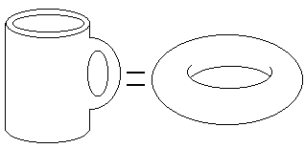
Topologically equivalent
A donut and a coffee cup are equivalent while a muffin and coffee cup are not.

Slide 6
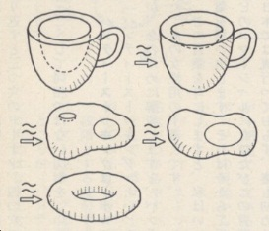

Slide 7
Exercise: Letters of Alphabet
A B C D E F G H I J K L M N O P Q R S T U V W X Y Z

Slide 8

Orientability and Genus
A topological surface is orientable if you can determine the outside and inside.
Any orientable, compact (finite size) surface is determined by its number of holes (called the genus).

Slide 9
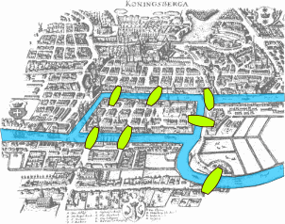
Some History of Topology
Begins with the Konigsberg Bridge Problem
http://nrich.maths.org/2484

Slide 10
Some More History: Euler and Topological Invariants
First example of a topological invariant: if g is the number of holes, v is number of vertices, e is number of edges, f is number of faces, then
V + F - E = 2 – 2g (Lhuilier 1813)
In particular, for polyhedra we have
V + F - E = 2 (Euler 1750)

Slide 11
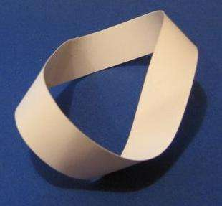
Some More History: Mobius and Orientability (1865)
Start with a strip of paper and join ends after twisting the paper once
Compare with the annulus that is formed with no twists

Slide 12
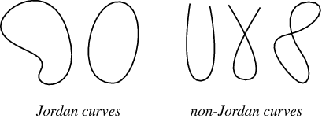
Some More History: Jordan and Simple Closed Curves (~1909)
A Jordan curve is a simple closed curve (continuous loop with no overlaps)
Every Jordan curve divides the plane into two regions: an interior and an exterior
https://www.youtube.com/watch?v=hnds9-GmwkM

Slide 13
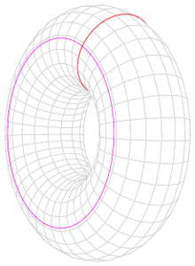
Some More History: Poincare Conjecture (1904)
http://www.factmonster.com/spot/poincare-conjecture.html
https://www.youtube.com/watch?v=9sfkw8IWkl0

Slide 14
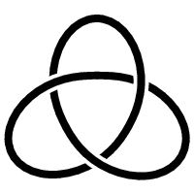
Knots
a knot was first considered to be an combination of circles interwoven in 3-dimensional Euclidean space
Note that in the topological study of knots, the ends are joined, as opposed to the traditional rope with 2 ends.

Slide 15
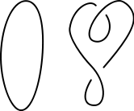
Knot equivalence
Knots are equivalent if one can be created from the other, and the process can be reversed without tearing the closed knot.
An example of this would be to twist the loop or unknot

Slide 16
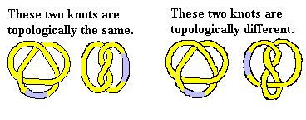


Although the unknot twisted is equivalent to putting a twist in that knot, the donut is not equivalent to a donut with two holes. This is because by folding the donut, you would have to attach it in the centre, and then tear it to indo the operation.

Slide 17
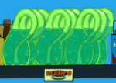
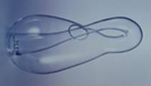
The Klein Bottle
The Klein Bottle is a closed surface with Euler characteristic = 0 (topologically equivilant to a sphere)
The Klein Bottle is made such that the inside and outside are indistinguishable
The TV show Futurama once featured a product know as Klein Beer, seen to the bottom right.
http://www.youtube.com/watch?v=E8rifKlq5hc

Slide 18
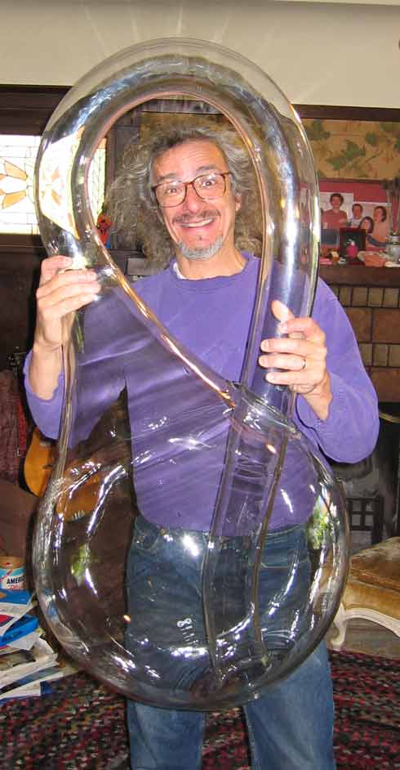
World’s Largest Klein Bottle
The Acme Klein Bottle was created by Toronto's Kingbridge Centre
1.1 meter tall, 50 cm diameter, and is made of 15 Kg of clear Pyrex glass.
It's the size of a 5 year old child.

Slide 19
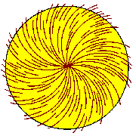
The Hairy Ball Theorem
Basically, if you have a tennis ball, or some other spherical object covered in hair, you cannot comb the hair all the way around the ball and have it lay smooth.
The hair must overlap with another hair at some point.
Famously stated as "you can't comb a hairy ball flat".
First proved in 1912 by Brouwer.

