Slide 1
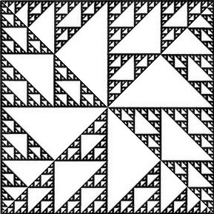
Using Triangle Sierpinski Relatives to Visualize Subgroups of the Symmetries of the Square
Tara Taylor ttaylor@stfx.ca
Department of Mathematics and Statistics
St. Francis Xavier University, Antigonish, NS, Canada
Bridges Halifax 2023
Notes:
Thank organizers, always inspiring to be here. This work is what happened when I would get frustrated with more theoretical stuff, I would play around with these beautiful fractals

Slide 2
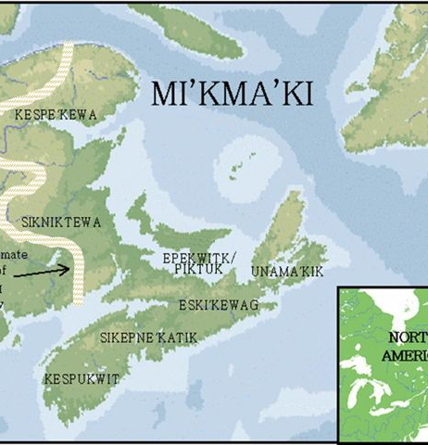
Land Acknowledgement
I would like to begin by acknowledging that we are in Mi’kma’ki, the ancestral and unceded territory of the Mi’kmaq People. Antigonish is of Mi'kmaq origin.
According to Dr. Silas Rand, it is derived from “Nalegitkoonechk”, meaning "where branches are torn off." It is said that there the bears broke down branches to get the beech nuts.
Second opinion: derived from "Nartigonneich" which translates to "a river of fish with many waters" or "the place where the waters meet."

Slide 3
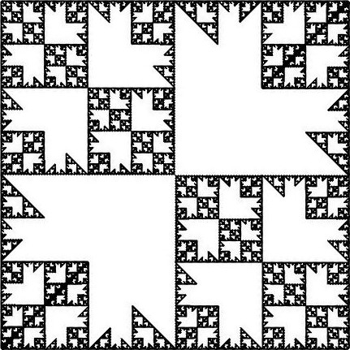
Outline
Intro
Math Background: Groups, symmetries of the square, iterated function systems, convex hulls
Triangle Sierpinski Relatives
Building new fractals

Slide 4
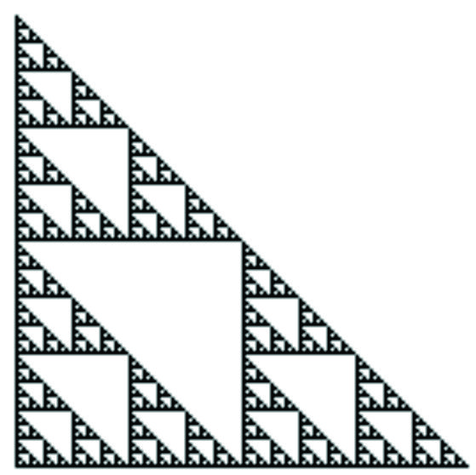

Sierpinski Gasket
Well-known fractal that can be expressed as the union of three smaller versions of itself (lengths scaled down by a factor of 2)
fractal dimension equals $\frac{\ln{3}}{\ln{2}}≈1.585$

Slide 5
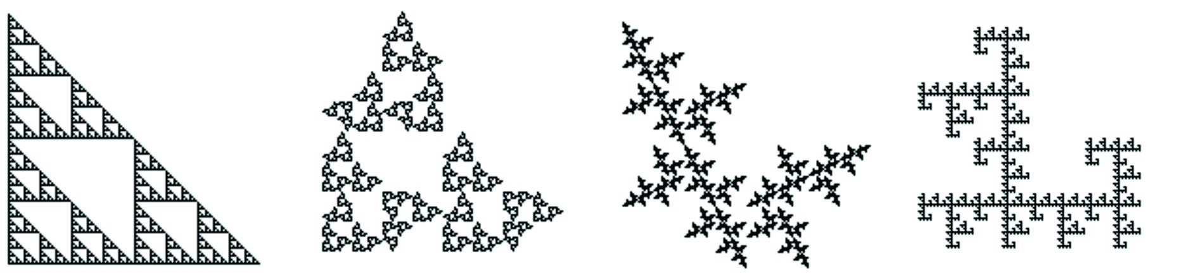
Sierpinski Relatives
Relatives possess the same scaling properties and hence the same fractal dimension
The topological properties vary
The gasket is multiply-connected (possesses holes)
Possible for a relative to be completely disconnected, disconnected with straight line segments, or simply-connected (no holes)
Notes:
I have been looking at the topological properties for a while… it was supposed to be a summer project after I was done my thesis but it has been over 15 years… one approach has been to look at the fractals and their epsilon-hulls as epsilon varies. In developing theory I needed specific examples to look at it and the symmetric relatives are good ones because the calculations are easier due to the extra symmetry. And they are just really beautiful.

Slide 6
Groups
A group is a set of elements G with a binary operation * such that x*y ∈ G for all x,y ∈ G and
Associativity: x*(y*z) = (x*y)*z for all x,y,z ∈ G;
Identity element e such that x*e = x = e*x for all x ∈ G;
Every element x has an inverse y such that x*y = e = y*x.
The set of integers with addition is a group: the identity is 0; the inverse of x is -x.
The set of integers with multiplication is not a group: there is an identity but not every element has an inverse

Slide 7

Dihedral Groups
The nth Dihedral Groups, D_{n}, consist of the set of symmetries of the regular polygon with n sides under composition. D_{n} has 2n elements (n rotations and n reflections).
A group is abelian if the operation is commutative: x*y=y*x for all x,y ∈ G
D_{n} is not abelian
By Jim.belk - Modified from original Image File:Stop_sign_MUTCD.svg, Public Domain, https://commons.wikimedia.org/w/index.php?curid=7502151

Slide 8
D₄: Symmetries of the Square
What are the symmetries of the square?

Slide 9
Symmetries of the Square

Slide 10

Binary Operation Table
* | a | b | c | d | e | f | g | h
a | a | b | c | d | e | f | g | h
b | b | c | d | a | g | h | f | e
c | c | d | a | b | f | e | h | g
d | d | a | b | c | h | g | e | f
e | e | h | f | g | a | c | d | b
f | f | g | e | h | c | a | b | d
g | g | e | h | f | b | d | a | c
h | h | f | g | e | d | b | c | a
$x∗y$ means do $x$ first, then do $y$
Each is row by column
Order matters: $f∗b=g$ but $b∗f=h$
Identity is $a$
Every element has inverse

Slide 11
Subgroups
A subgroup of a group is a subset that is also a group under the same operation
Every group has itself and the set containing only the identity as subgroups

Slide 12


Iterated Function Systems
(IFS)
An iterated function system (IFS) is a collection of contractive mappings $\{f_{1},f_{2},…,f_{n}\}$.
A given IFS has a unique attractor $A$ that satisfies
$$A=f_{1}\left(A\right)∪f_{2}\left(A\right)…f_{n}\left(A\right)$$
Can start with any compact set and apply maps

Slide 13
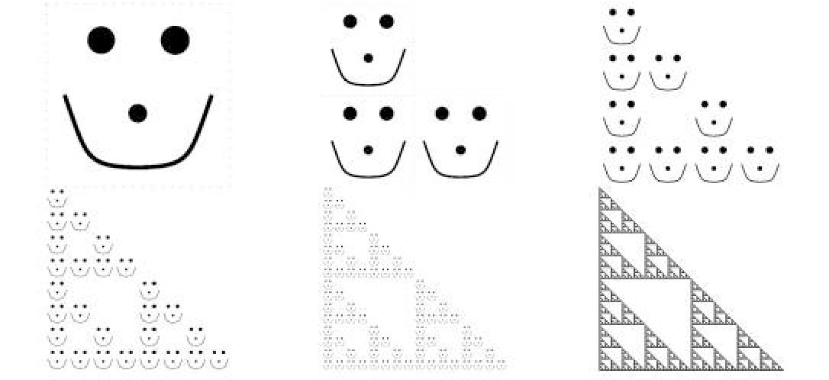

IFS
Form a sequence $\left\{A_{n}\right\}.$
$A_{0}=X$ and for $n≥1$:
$$A_{n}=\bigcup_{i=1}^{n}{f_{i}\left(A_{n−1}\right)}$$
The limit of the approximations as
$n→∞$ is $A.$

Slide 14

Generating the Relatives using Symmetries of the Square
Relative $R_{xyz}$ can be obtained from an IFS $\{f_{1},f_{2},f_{3}\}$ acting on the unit square $S$
$f_{1}$ involves contraction and the symmetry $x$
$f_{2}$ involves contraction, the symmetry $y$ and horizontal translation by ½
$f_{3}$ involves contraction, the symmetry $z$ and vertical translation by ½
Notes:
It starts off the same but the L shape will move

Slide 15
Example of Sierpinski Relative
$$R_{abd}$$

Slide 16
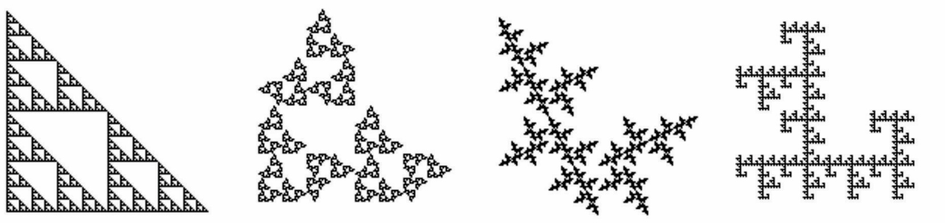
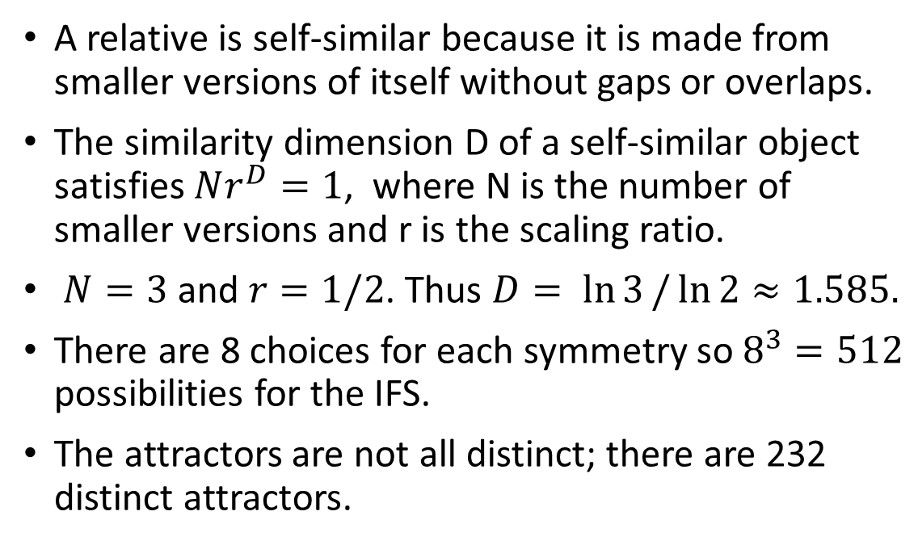
Sierpinski Relatives
A relative is self-similar because it is made from smaller versions of itself without gaps or overlaps.
The similarity dimension D of a self-similar object satisfies $Nr^{D}=1$, where N is the number of smaller versions and r is the scaling ratio.
$N=3$ and $r=1/2$. Thus $D= \ln{3}/\ln{2}≈1.585.$
There are 8 choices for each symmetry so $8^{3}=512$ possibilities for the IFS.
The attractors are not all distinct; there are 232 distinct attractors.
Notes:
I have been looking at the topological properties for a while… it was supposed to be a summer project after I was done my thesis but it has been over 15 years… one approach has been to look at the fractals and their epsilon-hulls as epsilon varies. In developing theory I needed specific examples to look at it and the symmetric relatives are good ones because the calculations are easier due to the extra symmetry. And they are just really beautiful.

Slide 17
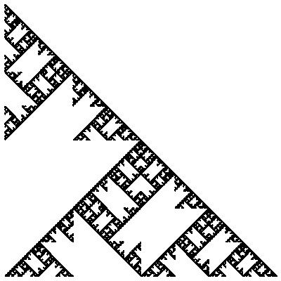

Congruent Pairs
Some relatives are symmetric via the diagonal symmetry $g$
$g$ is the only non-trivial isometry between two relatives
Non-symmetric relatives come in congruent pairs
$R$ and $R′$ are congruent if and only if $R′=g(R)$
Can obtain the unique congruent match to $R=R_{xyz}$ : $R^{′}=R_{uvw}$, where $u=gxg, v=gzg, w=gyg$
$R_{bag}$ and its congruent match $R_{dga}$

Slide 18
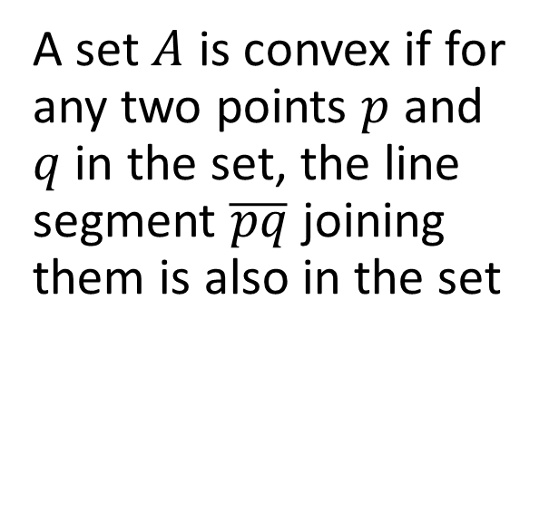
Convex Sets
A set $A$ is convex if for any two points $p$ and $q$ in the set, the line segment $\overline{pq}$ joining them is also in the set

Slide 19
Convex Hulls
The convex hull of a set is the smallest convex set that contains the set
Can visualize the convex hull of a set of points is that it includes its boundary which is like an elastic band around the points and it has everything inside the elastic band
Many real-world applications to convex hulls (ex. tumour analysis)
Notes:
Can say more about how in 2d it is determined by extreme points, notice that the slopes of the line segments are strictly increasing as we move counter-clockwise around

Slide 20
Triangle Relatives
These 8 relatives and their congruent matches are the only non-symmetric relatives that have the same triangle convex hull as the Sierpinski gasket

Slide 21
Square Fractals made with Triangle Relatives
Idea: find all non-trivial subgroups with the fewest number of triangle relatives

Slide 22
Square Fractals made with Triangle Relatives

Slide 23
Square Fractals made with Triangle Relatives

Slide 24
Square Fractals made with Triangle Relatives

Slide 25
Square Fractals made with Triangle Relatives

Slide 26
Square Fractals made with Triangle Relatives

Slide 27
Square Fractals made with Triangle Relatives

Slide 28
Square Fractals made with Triangle Relatives

Slide 29
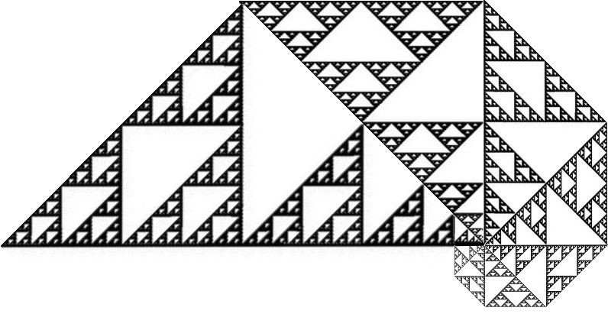
Squares are just the beginning…

Slide 30
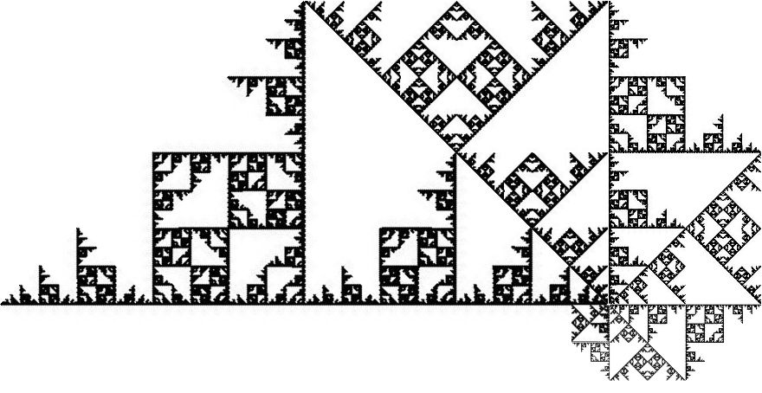
Thank you!
ttaylor@stfx.ca

